Slide 1
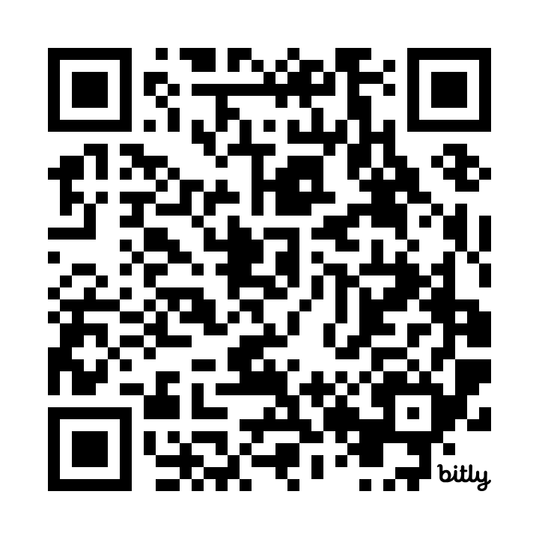
Innovation in Assistive Technology Tools:
Key Improvements &
Updates
Rachel Kruzel, ATP
AHEAD in Texas 2025
https://bit.ly/aheadintexastech2025

Slide 2

Hello There!
Rachel Kruzel, ATP
Strategic Customer Success Manager - Higher Education
Everyway (formerly Texthelp)
Email: r.kruzel@texthelp.com
Phone: 651-245-3128

Slide 3

Introducing Everway

Slide 4
Today’s Agenda
Our Students & Learner Preparedness
Digital Transformation
Artificial Intelligence
Learner-Centered Adoption
Data & Analytics

Slide 5
Our Students & Learner Preparedness

Slide 6
Students of today
Students of today have an ever growing unique profile
Students with disabilities, connectedness and diagnosis, neurodiversity, mental health
Struggling learners, academic preparedness, skill preparedness, executive functioning, literacy
Learners of today/returning, dual enrollment, specific populations

Slide 7
Campus Focuses
Inclusive education
Data-driven decision making (AROI)
Online and hybrid learning growth
Digital Transformation
Learner-centered adoption
Learner-preparedness

Slide 8
Disclosure Data Points
37%
70%
of higher education students with a disability reported it to their institution.
70%
of higher education students with a mental health condition do not register for accommodations.
37%
Mental Health America. (2020.). 2020 disability and Campus Mental Health Report. 2020 Disability And Campus Mental Health Report. Retrieved from: https://mhanational.org/get-involved/2020-disability-and-campus-mental-health-report
National Center for Education Statistics. (2022, April 26). A Majority of College Students with Disabilities Do Not Inform School, New NCES Data Show. Retrieved from: https://nces.ed.gov/whatsnew/press_releases/4_26_2022.asp

Slide 9

Disability and Neurodiversity
Students with disabilities, those who identify as neurodiverse and those who have a mental health condition make up a large part of college and university populations
19.4%
11-30%
>60%
of college students reports having a disability.¹
Number of college students who identify as neurodiverse.²
of college students meet the criteria for least one mental health condition.³

Slide 10

Weis, R., Waters, E.A. Evidence-Based Accommodations for Postsecondary Students with Disabilities: Beware the Base Rate Fallacy. Psychol. Inj. and Law 16, 213–226 (2023). https://doi.org/10.1007/s12207-023-09471-7
“A large, diverse sample of undergraduates with and without disabilities rated their academic functioning across multiple domains… Overall, 95.5% of students with disabilities an 90.0% of students without disabilities reported at least one substantial limitation in academic functioning.”

Slide 11


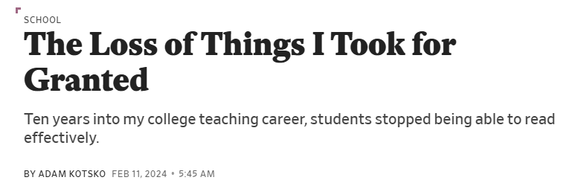
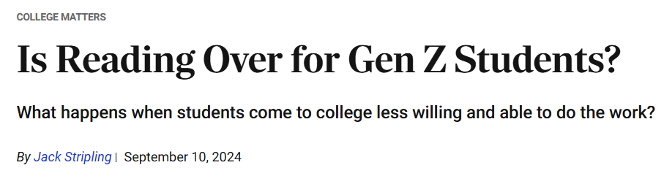
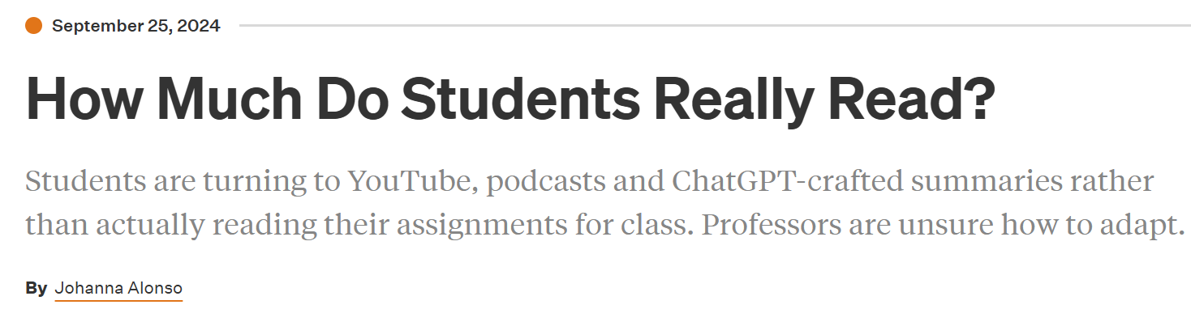

In the Headlines

Slide 12
Article Links
Slate: The Loss of Things I Took for Granted
The Atlantic: The Elite College Students Who Can’t Read Books
Inside Higher Ed: How Much Do Students Really Read?
The Chronicle: Is This the End of Reading?
  College Matters Podcast: Is Reading Over for Gen Z Students?
The Chronicle of Higher Education: Declarations of Dependence - The Many reasons students can't, or won't, work on their own.

Slide 13
Pair & Share - Preparedness
Is your campus experiencing students, such as those in these articles in regards to reading preparedness? Share what you are hearing or what campus is discussing about these students. What is your campus doing to address this?
What areas are students coming to your campus needing the most coaching, skill building and support as it relates to effective studying and engagement with course content?

Slide 14
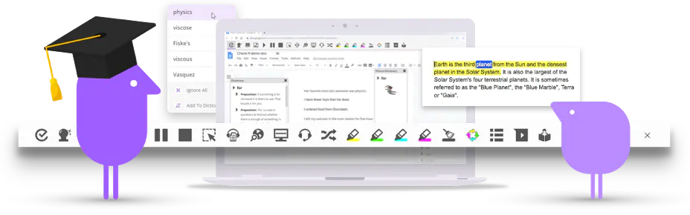

Read&Write
Help students understand, engage and express themselves
Read&Write is a literacy support tool that offers help with everyday tasks like reading text out loud, understanding unfamiliar words, researching assignments and proofing written work.

Slide 15

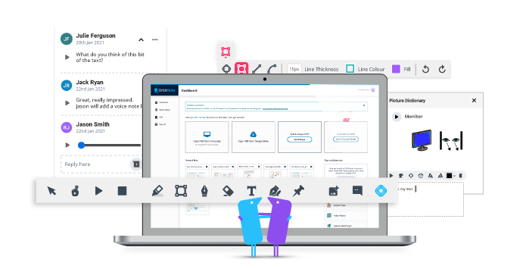
OrbitNote
Create, convert, connect:
Take your documents to the next level
OrbitNote allows you to transform and interact with documents in a completely different way. Create an accessible, dynamic and collaborative space that works for everyone.

Slide 16
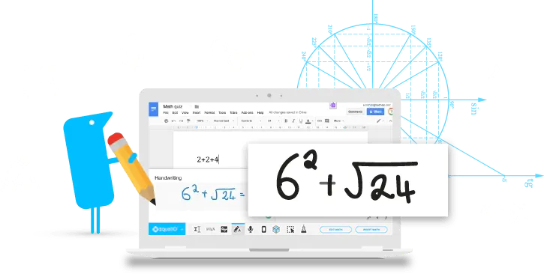


Equatio
Make math Digital
Equatio allows you to create equations, formulas, and more, digitally. Helping to make math and STEM classes more accessible and engaging for every student.

Slide 17

Let’s Take a Peek - Learner Preparedness

Slide 18

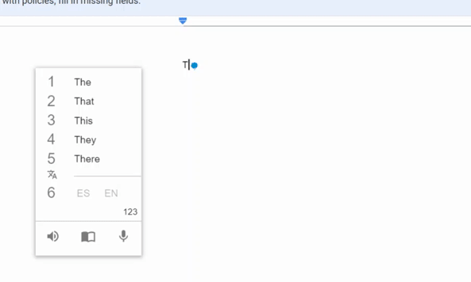
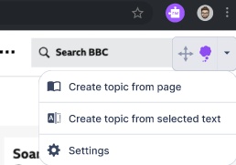



Custom topics
Translation writing support
What’s next
Create your own topics from a website or selected text, to see more subject-specific words in your prediction list.
Type or speak a word in your first or preferred language, and have it translated to English.

Slide 19
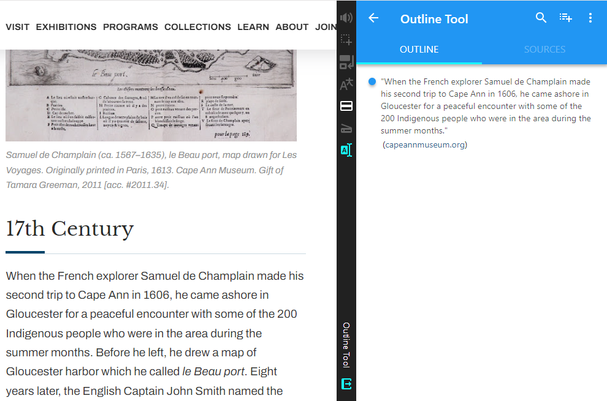
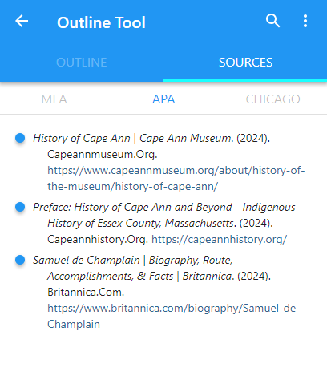
Outline Tool
Citation Generator
What’s next
Create your own Outline with quotes from multiple resources into a single outline
Automatically save citation information and provide citation support for MLA - APA - Chicago.
Note: screenshots from current Snap&Read tool and not representative of future design in Read&Write

Slide 20
Learner-Centered Adoption

Slide 21
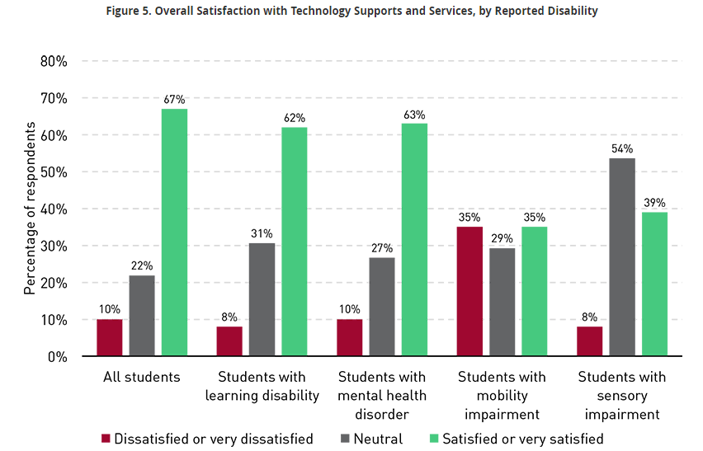
Satisfaction with Technology
“Advancements in technology have opened up opportunities for individuals who may have previously faced barriers to education, although they still aren't equal to the experiences of students without disabilities…”
From EDUCAUSE: Educational Technology Research in Higher Education: New Considerations and Evolving Goals - Information, Tools, and Access at All Levels

Slide 22
Students at the center
Why we are in our roles
Students have opinions, want to be involved
Articles coming out about students having voice and choice and understanding of “why” things are happening
Focus groups, surveys, feedback channels
What have students used before - tools and platforms?

Slide 23
Pair & Share – Learner-Centered Adoption
What do students (or faculty and staff) need to be successful in the onboarding and use of a new type of technology?
How can we foster buy-in and support the use of technology for the students we work with or those in the wider campus population?

Slide 24
Let’s Take a Peek - Learner-Centered Adoption

Slide 25

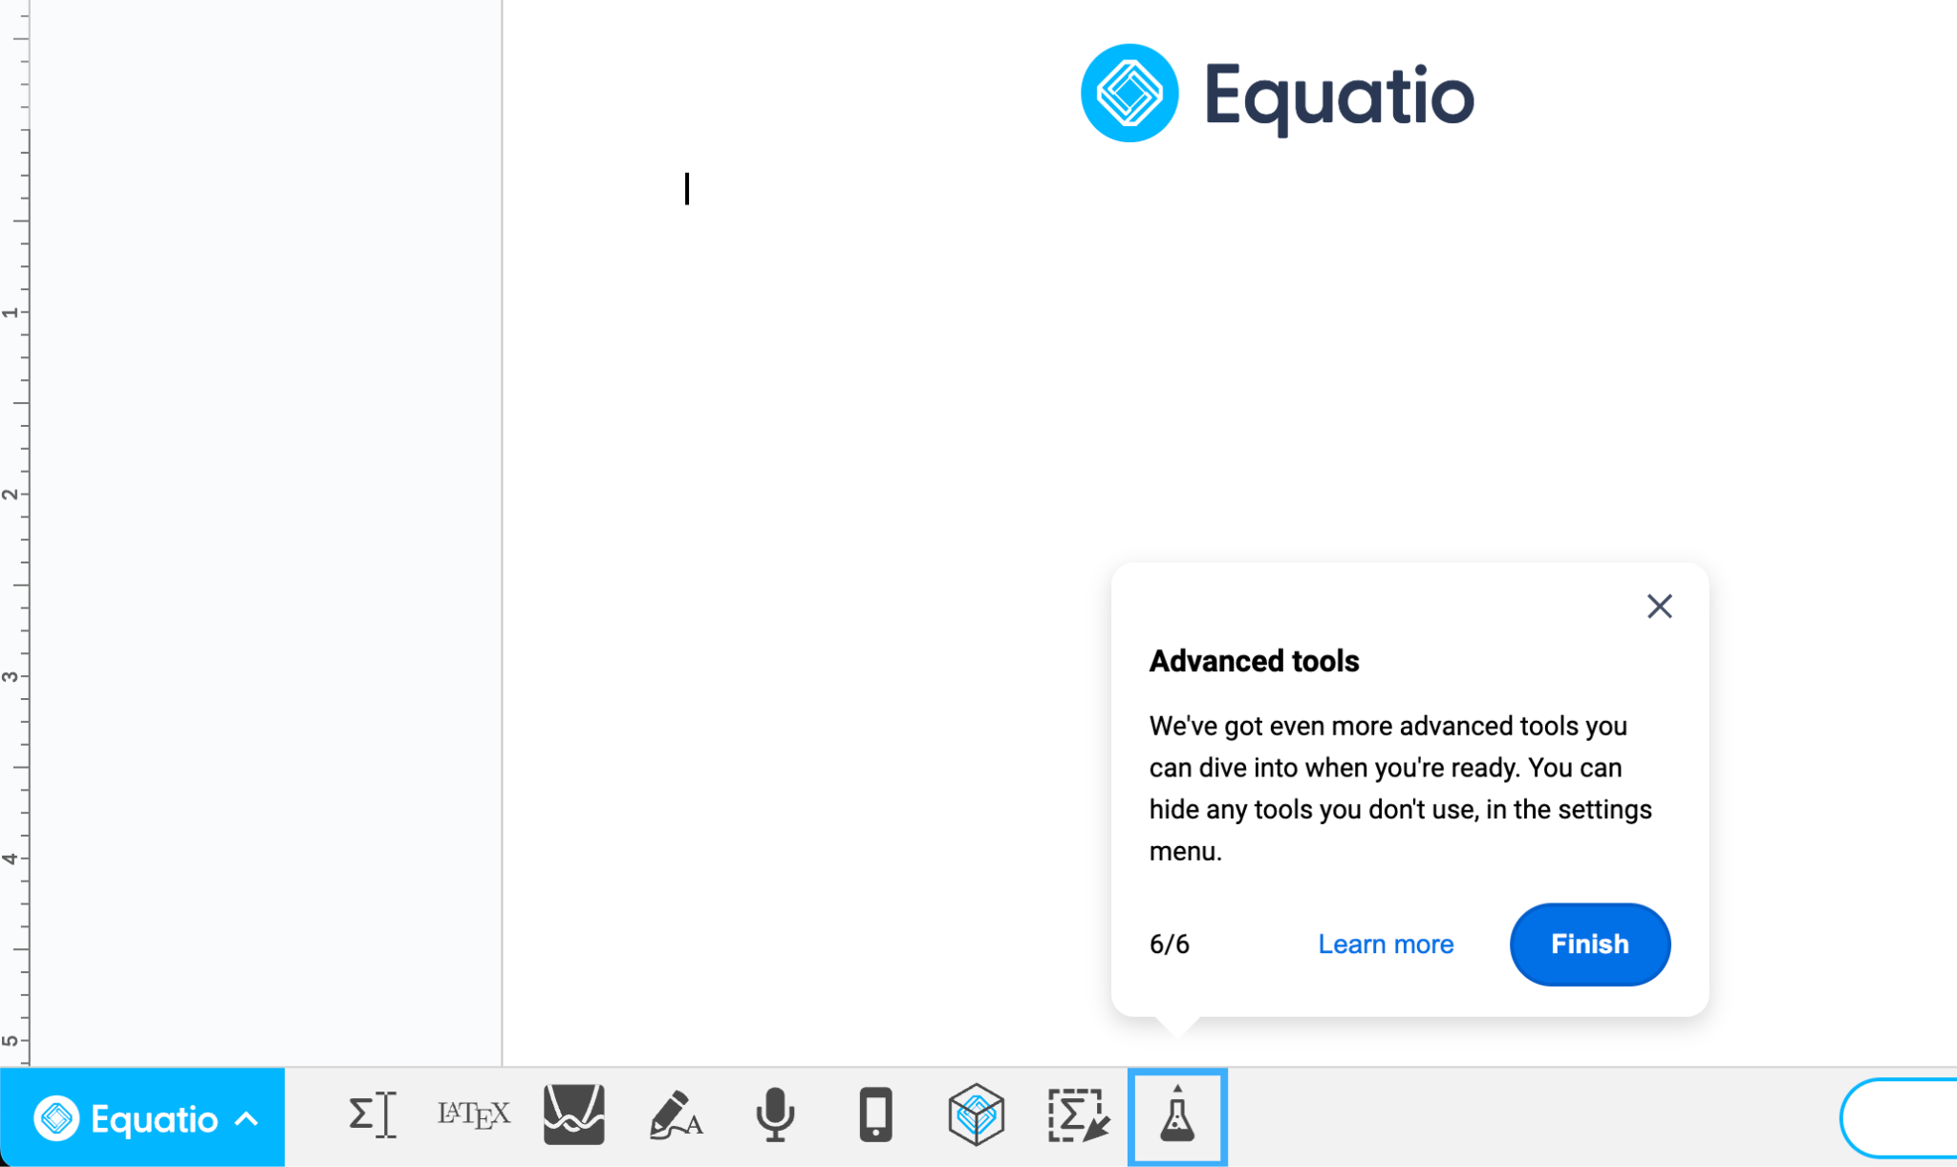
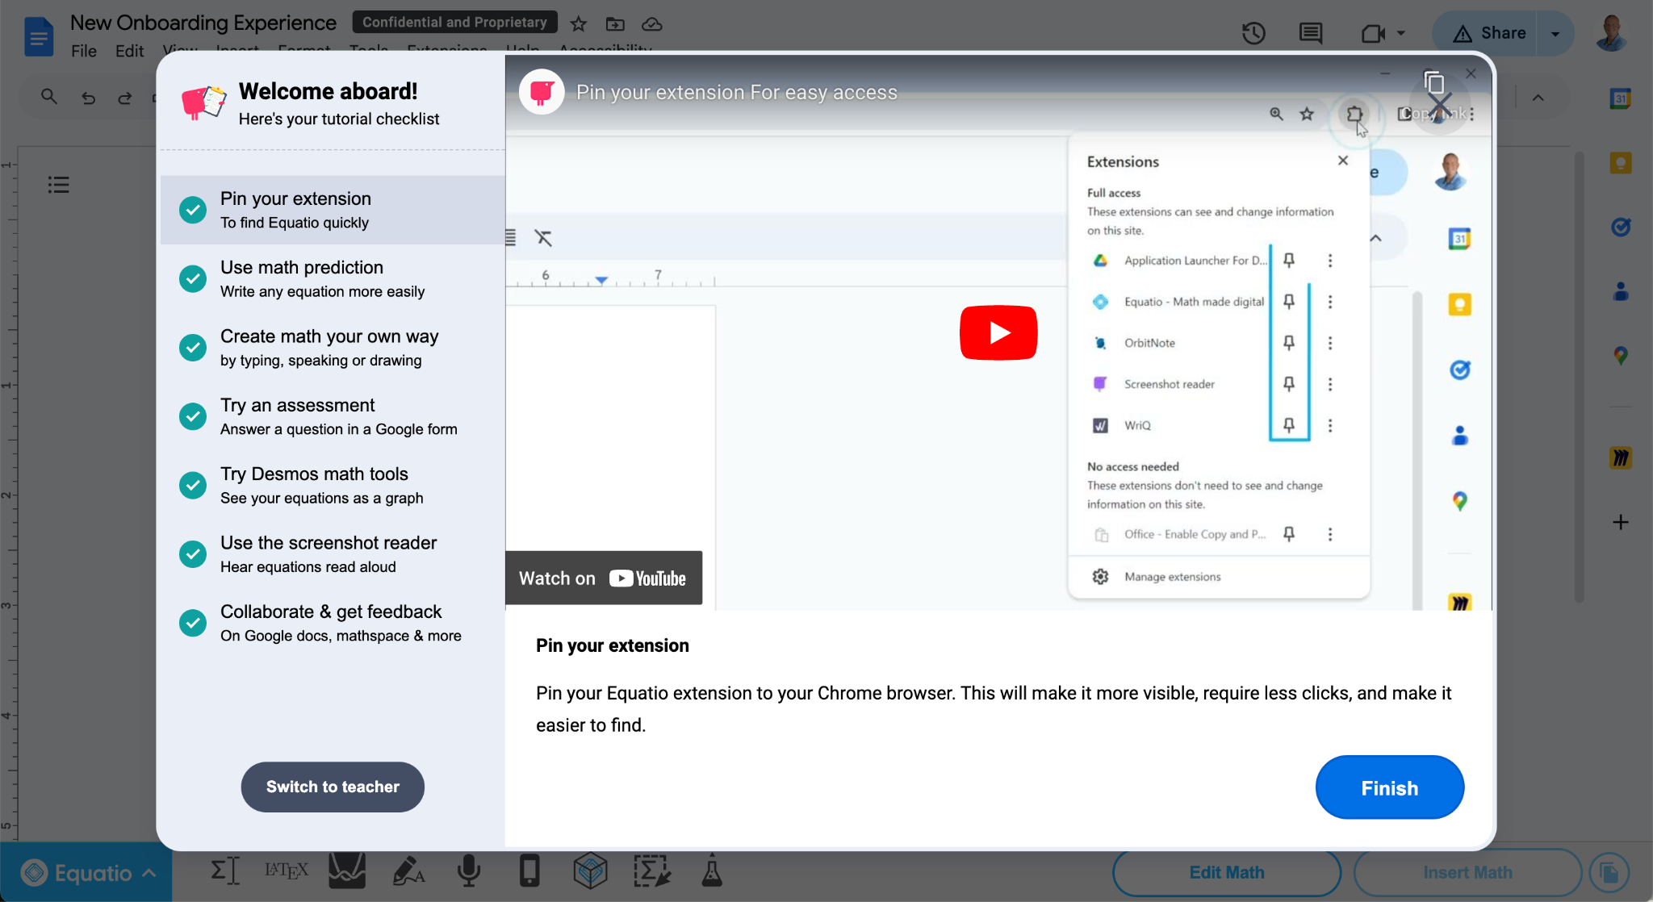
The New Experience Contains 2 Ways In Which A Learner Can Use The Product
Product Tour
Video Tutorials/w Checklist
The New Equatio Onboarding Experience
The New Equatio Onboarding Experience

Slide 26
Digital Transformation

Slide 27
What’s Digital Transformation
“Digital transformation in higher education is the strategic use of digital technologies to improve the educational experience and how institutions operate. It involves a comprehensive approach that changes how institutions deliver value to students and staff, and requires a strategic approach across multiple departments, faculties, and campuses.”

Slide 28
What’s Digital Transformation Numbers
“About two out of three CTOs said the digital transformation of their institution is essential (23 percent) or a high priority (39 percent).” - From Inside Higher Ed article
“Regarding their institution’s priority areas for digital transformation efforts, many CTOs (81 percent) cited student success.”- From Inside Higher Ed article

Slide 29
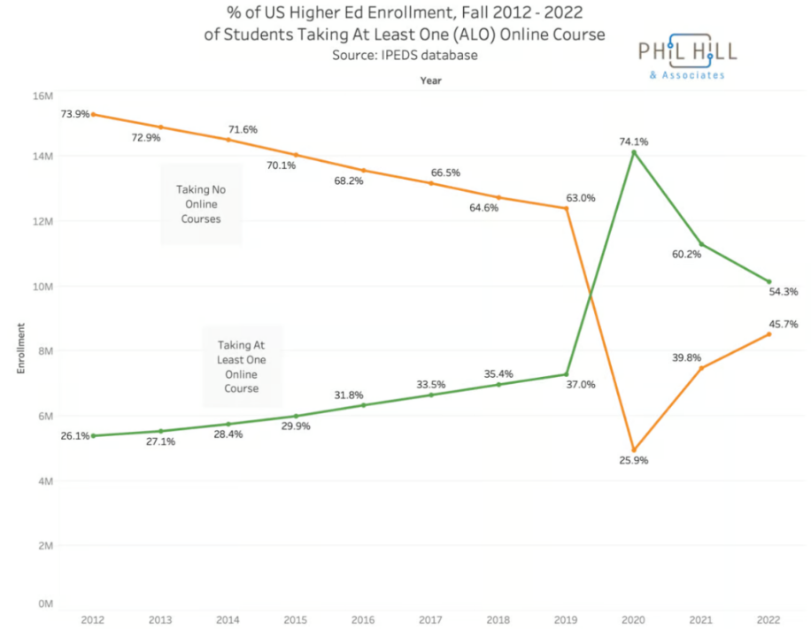
Online Learning Statistics
54%
of college students took one or more of their classes online in fall 2022
SOURCE: Proof Points: Most college kids are taking at least one class online, even long after campuses reopened

Slide 30
Evolution of education online
Enrollment of one or more online classes has increased since 2012
“Institutions should plan for 75% of overall enrollment to be online and 25% in-person in the next 10 years as online continues to expand rapidly.” - From 10 trends to watch in distance learning from American Association of Community Colleges
Student preference, flexibility, mental health, loneliness epidemic

Slide 31
Pair & Share – Digital Transformation
Is your campus focused on digital transformation? Are you involved in any of these conversations?
What is your campus doing to focus on digital transformation to provide sustainable support for the learners coming to your campus this coming year and beyond?

Slide 32
Let’s Take a Peek - Digital Transformation

Slide 33





Platform integrations
Google Chrome Extension
Microsoft Edge Extension
Windows Desktop
Mac Desktop
Android Tablet
iPad & iPhone

Slide 34
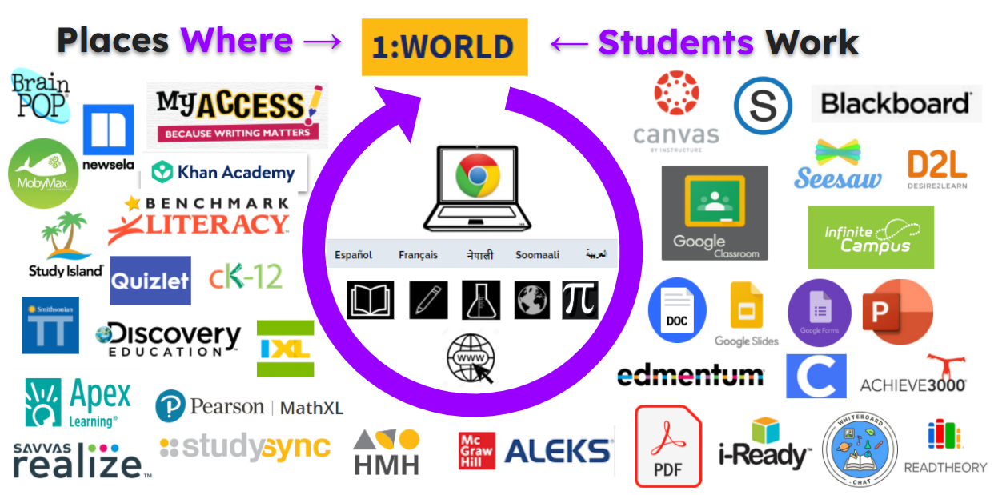

Integration in education is key
For education to truly be inclusive and equitable, tools should be available for all learners in all environments, no matter the place or assignment given.

Slide 35
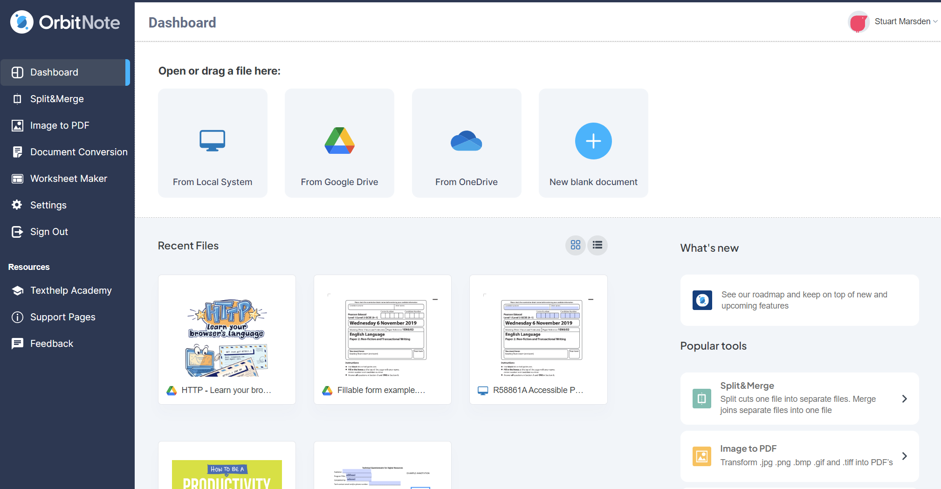
OrbitNote Modern Dashboard

Slide 36
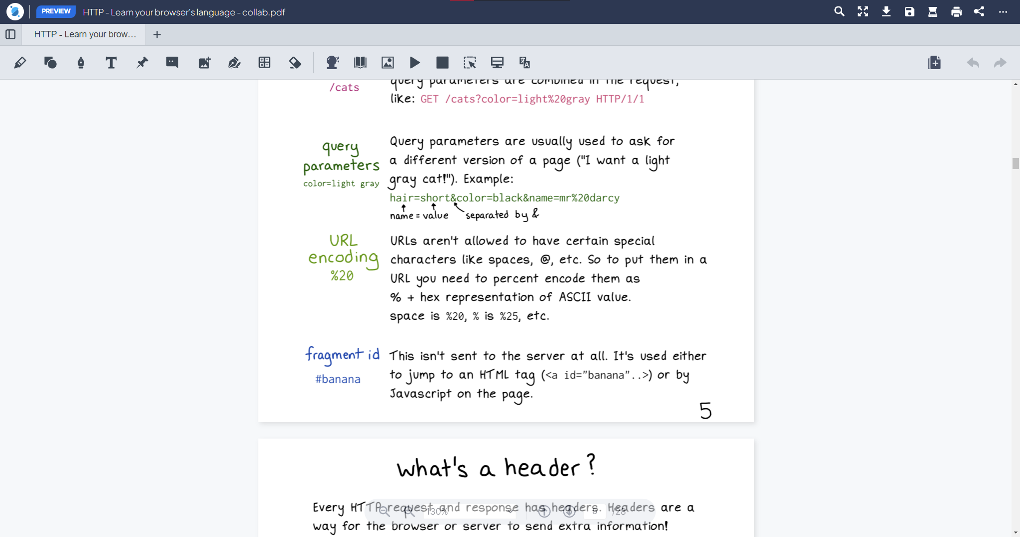
OrbitNote Modern Interface

Slide 37

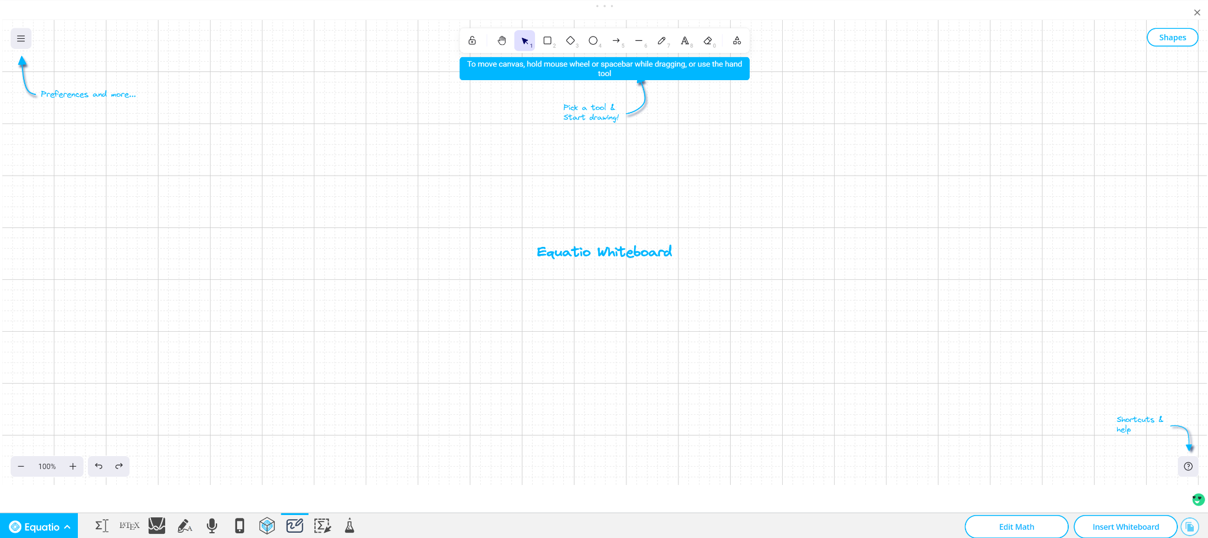
New Input Method!
Whiteboard Tool

Slide 38
Data and Analytics

Slide 39
Show me the data!
Data driven decision making is essential
Academic Return on Investment (AROI)
Understanding baseline levels of use, goal setting, active implementation strategies, accountability

Slide 40
Pair & Share – Data & Analytics
How is data talked about on your campus?
How central is data and analytics central to the request for supports, staffing and technology to support the efforts of your office and the wider campus community?

Slide 41
Let’s Take a Peek - Data & Analytics

Slide 42
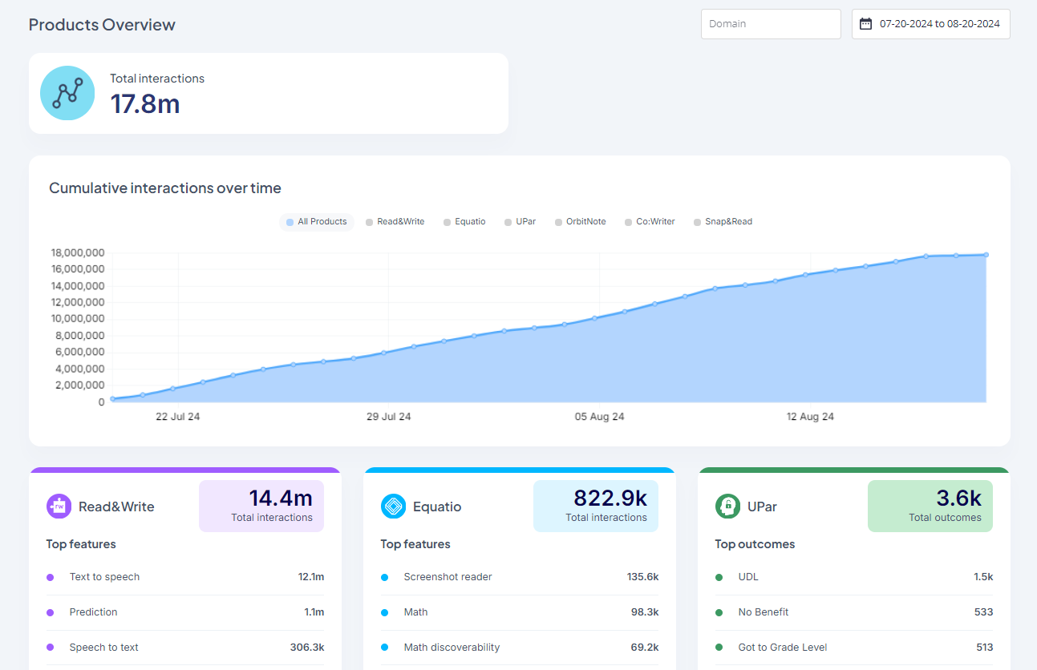
What is the Data Dashboard?
The Data Dashboard is an overview of data engagement trends for all your Texthelp products
What you can see in your data dashboard:
  Total interactions
  An interaction is any meaningful way that a user interacts with the procut - clicks, inserts, and other actions.
Engagement trends based on date range with default set to 1 month from current date
Access: datadashboard.texthelp.com - reach out to be added

Slide 43
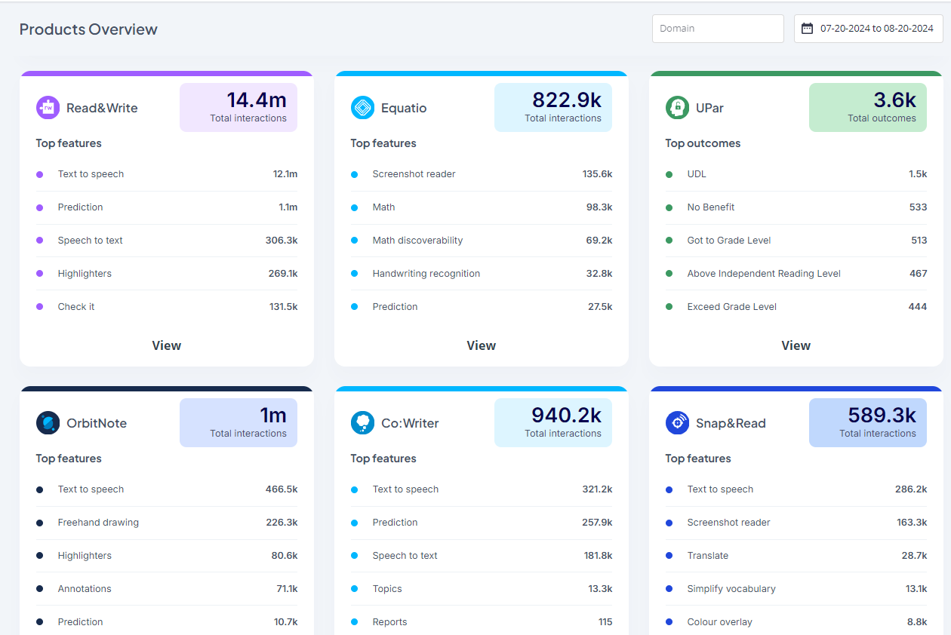
Data Dashboard Homepage
Dashboard homepage
Scroll down to view tiles for each of your products
Total number of interactions across the whole domain
List of top features used
Click View on a product to dive in further

Slide 44
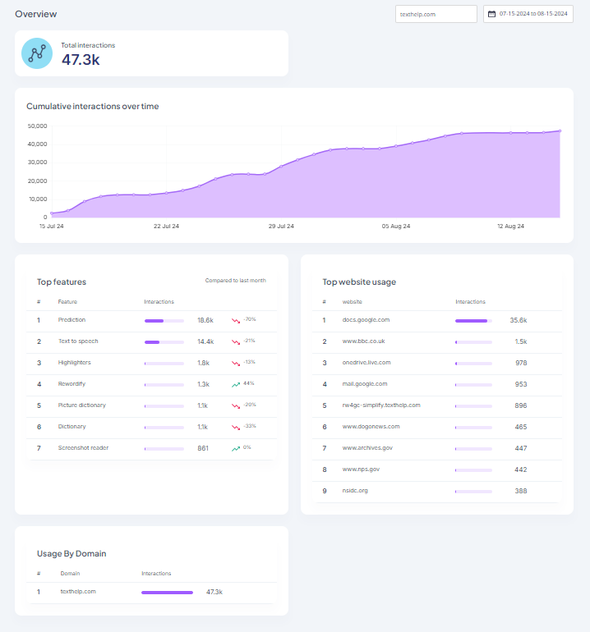
Product Analytics
For each product:
Each product page provides a high level look at total usage, as well as more detailed insights into top features used and top websites for certain products.
The available data includes:
Total number of interactions across the domain
Cumulative usage over time
Top features used and % change compared to the previous time period
Top websites where the tools are used (where available)
Usage broken down by domain

Slide 45
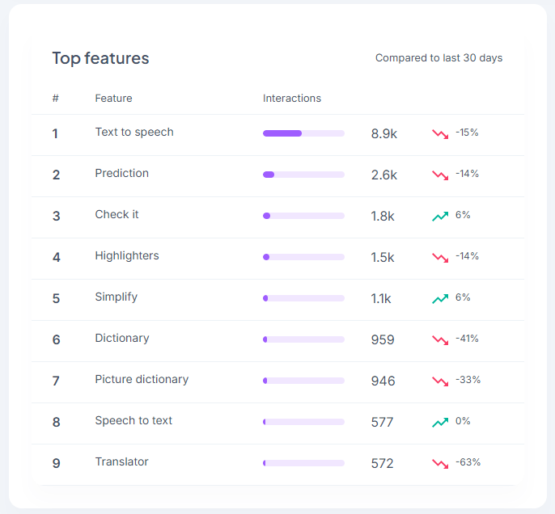
Top Feature analytics
Top Features
Number of interactions
% of increase or decrease as compared to date range

Slide 46
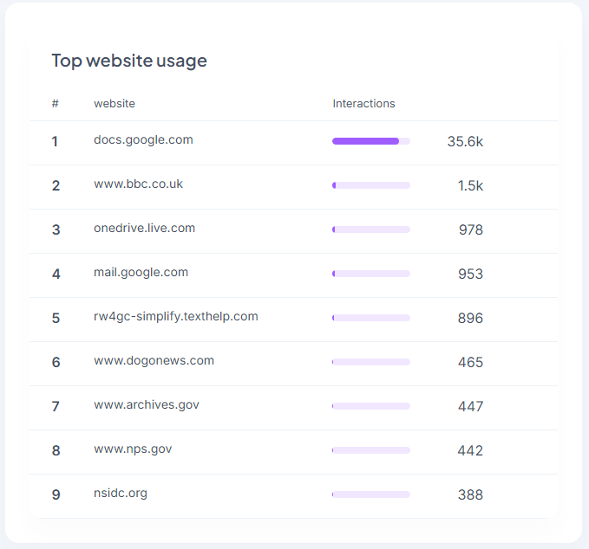
Top Website Analytics
Top website usage

Slide 47
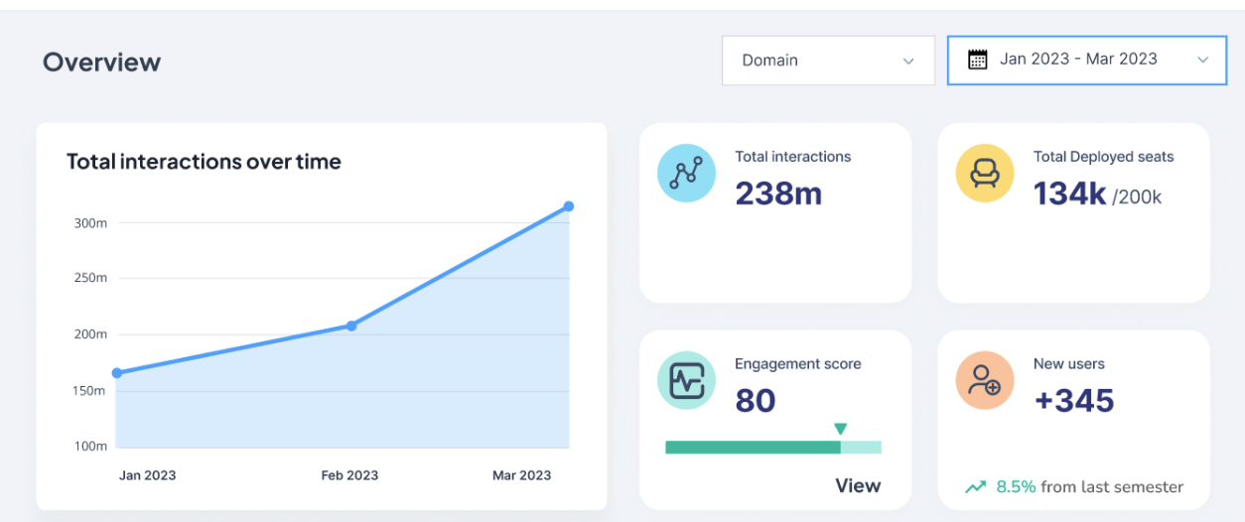
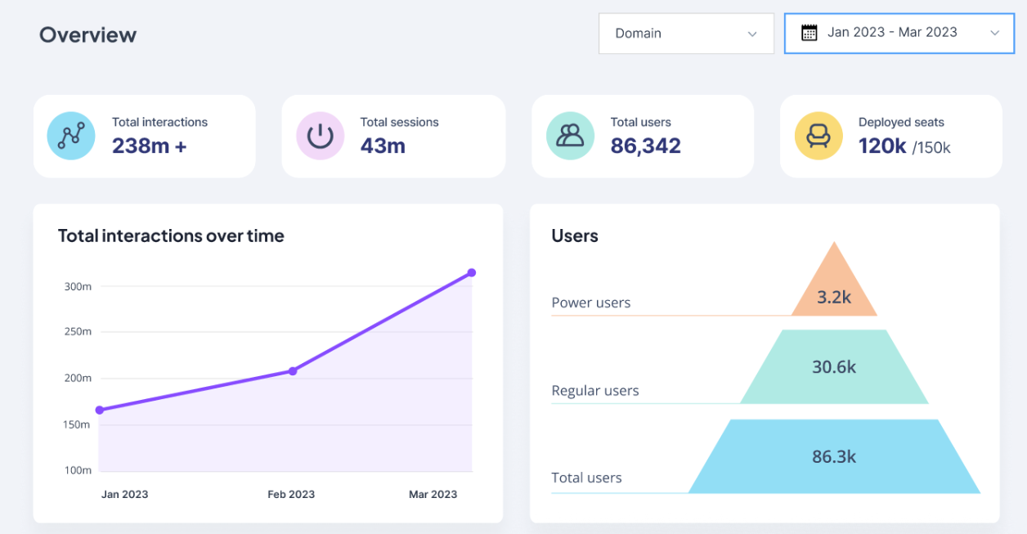
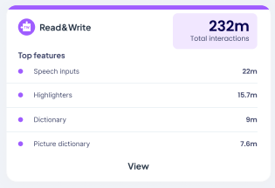
Data Dashboard Roadmap
The Data Dashboard has an exciting roadmap.
This includes things like…
User analysis - breakdown of data like deployed seats, total users, and active users
Desktop usage statistics
Turning features on and off (certain LMSs and sign in methods)

Slide 48
Artificial Intelligence

Slide 49
Artificial Intelligence Sentiments
Tech - embracing AI, imbedding in our institutions
Students - actively using
Faculty
Disability Resources & Staff

Slide 50
Artificial Intelligence Numbers
“...9 percent of chief technology officers believe higher education is prepared to handle the new technology’s rise.”
“...most are concerned about AI’s growing impact on higher education, with 60 percent worried to some degree about the risk generative AI poses to academic integrity, specifically.”
From: Most Campus Tech Leaders Say Higher Ed Is Unprepared for AI’s Rise

Slide 51
Artificial Intelligence Numbers cont.
“The CTO survey found that the most popular applications of AI after chat bots included enhancements of cybersecurity (35 percent), predictive analytics for student performance and trends (27 percent), research and data analysis (24 percent), and learning management systems (20 percent).”
“Only 3 percent of institutions use AI for facilities management or creating personalized learning pathways; 11 percent use it for institutional planning and decision-making, student engagement, and fundraising; 17 percent use it for admissions and administration processes (such as scheduling and resource allocation); 14 percent use it for student advising and support; and 12 percent use it for grading and assessment.”

Slide 52
Pair & Share - AI
Where is your campus on their AI journey? What are the general sentiments on your campus about AI use and adoption?
How or in what ways is your campus adoption or (rejecting) AI academically to support your learners?

Slide 53
Let’s Take a Peek - AI

Slide 54
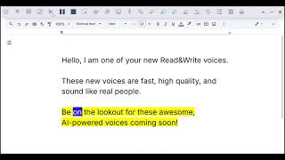
New Voices (finally!)
Introducing new, AI-powered text to speech voices made by ElevenLabs.
These will be premium voices added to Read&Write for Google Chrome first, and more products to follow.

Slide 55
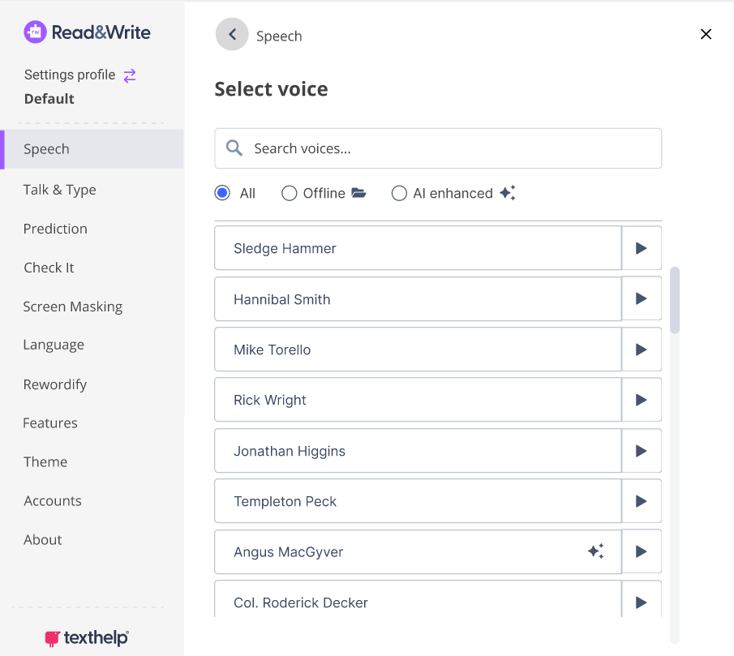
New and improved voice list
The new voice list will make it easier for students to find the voice that works best for them.
This includes new filtering options, and the ability to preview what the voices sound like.

Slide 56
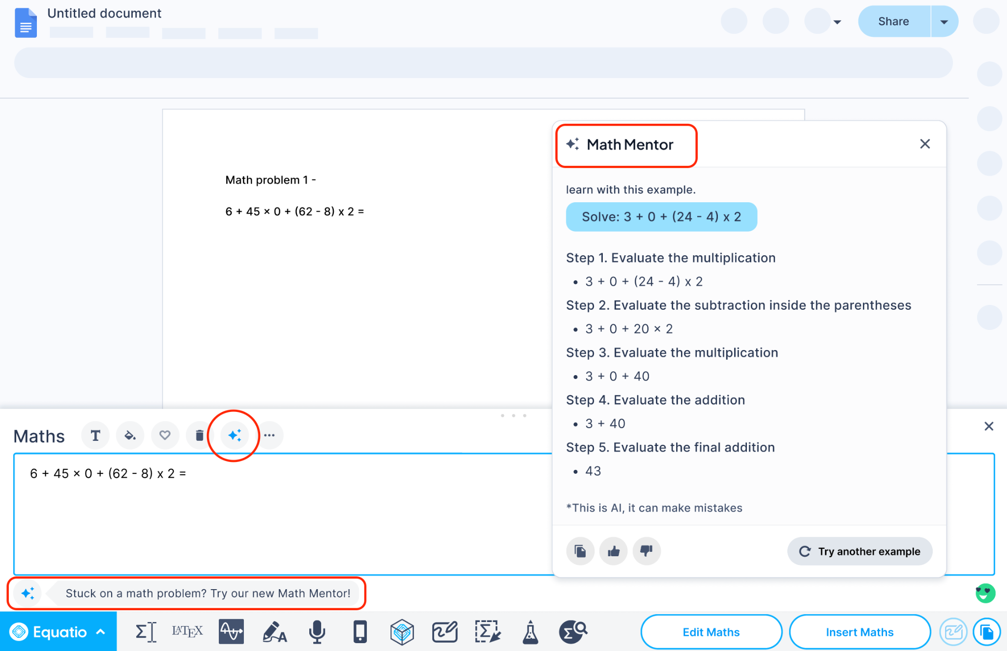
Equatio Math Mentor
Academic integrity considerations - does not give answer to problem
Embedded in the tool for ease of use and access
Ability to turn on and off for assessment

Slide 57
Questions & Discussion

Slide 58
Let’s Connect!
Rachel Kruzel, ATP
Strategic Customer Success Manager - Higher Education
Everyway (formerly Texthelp)
Email: r.kruzel@texthelp.com
Phone: 651-245-3128

