Slide 1
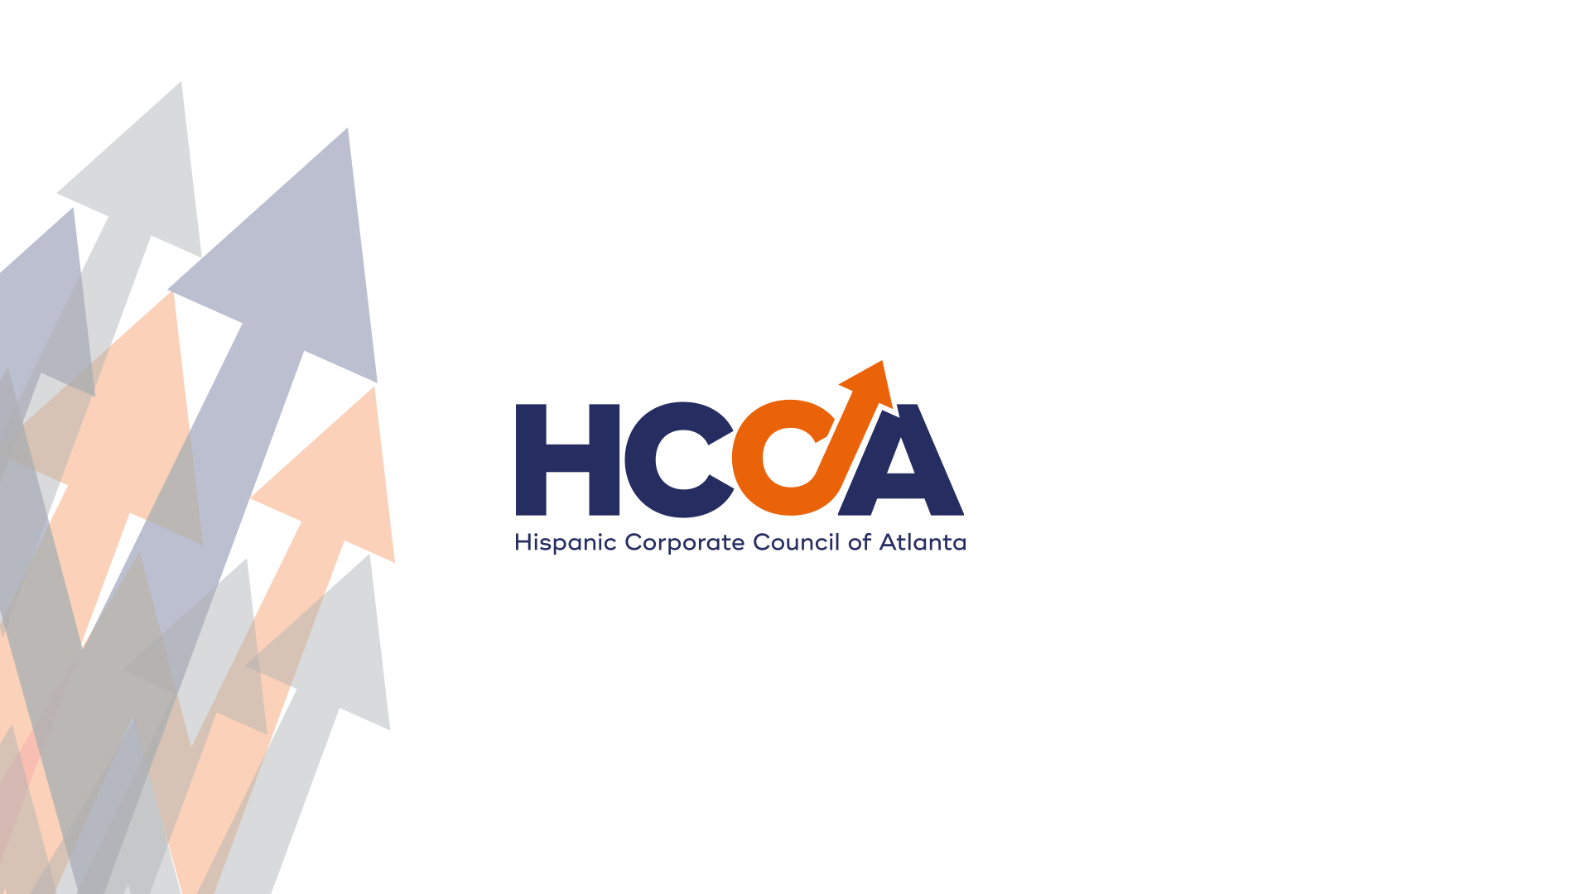

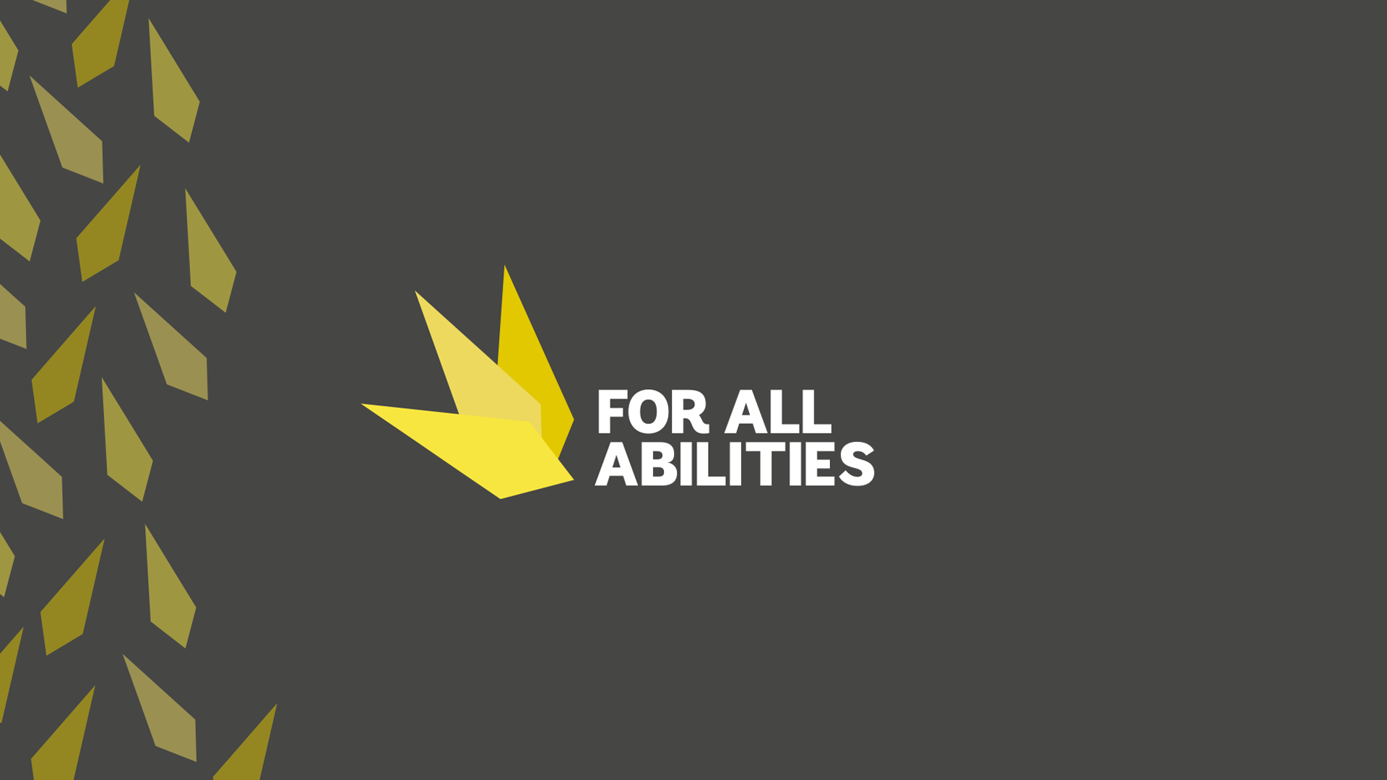
March 3, 2016

Slide 2

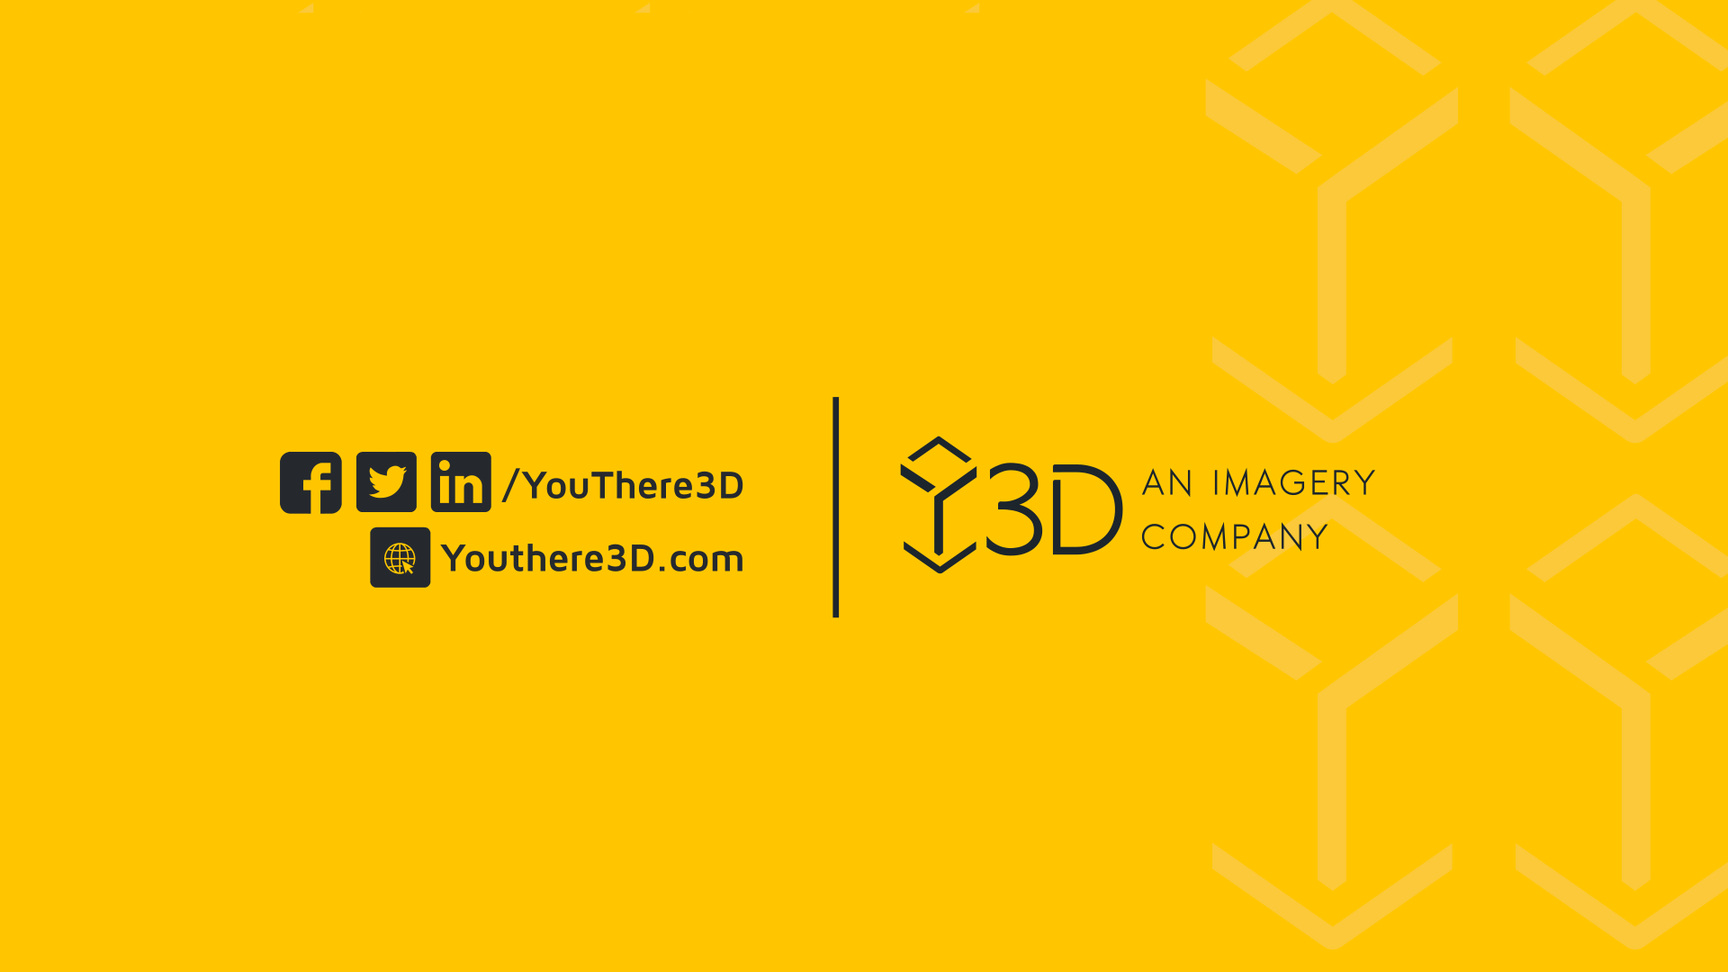

Creative Supports for Students
Betsy Furler

Slide 3

The Growing Challenge
More students are entering college unprepared, lacking formal study skills and facing rising requests for accommodations, often without formal diagnoses.
1. Increased Distractions & Digital Overload
Constant notifications, social media, and streaming services make focused study time harder to maintain.
Multitasking with technology can reduce deep learning and retention.
2. Less Experience with Independent Learning
Many high schools emphasize structured learning and frequent reminders, so students aren’t used to managing coursework independently.
Some students rely on short-term memorization rather than developing critical thinking and problem-solvingskills.
3. Mental Health & Stress Levels
Anxiety, depression, and burnout have increased significantly among college students.
Balancing academics, work, and personal life is harder than ever, especially with financial pressures.
4. More Responsibilities & Less Free Time
Many students work part-time or full-time to afford college, leaving less time for studying.
Increased expectations for internships, extracurriculars, and networking add to the workload.
5. Post-Pandemic Learning Gaps
Online and hybrid learning during COVID-19 weakened study habits for many students.
Some missed out on fundamental skills in high school, making the transition to college harder.

Slide 4


UMAK
Common Readiness Gaps
Time Management – High school schedules are structured, while college demands independent planning. Many students struggle with prioritizing tasks.
Study Skills – Memorization-based studying in high school doesn’t always translate well to college’s deeper analytical demands.
Reading & Note-Taking – College readings are longer and denser, and many students don’t know how to take effective notes.
Test-Taking – Exams are less frequent but more challenging, requiring strong critical thinking skills.
Self-Discipline & Motivation – Without parents and teachers constantly reminding them, some students struggle to stay on track.
Powerpoint Template
March 3, 2016

Slide 5



The Power of Creative Supports
Beyond Traditional Accommodations
Empowering Students
Leveraging Free and Low-Cost Tools
Moving past conventional methods to offer innovative support tailored to individual needs.
Equipping students with the skills and resources to implement effective strategies on their own.
Apps and software and abundant. Students can use their personal tech devices to get powerful support.

Slide 6
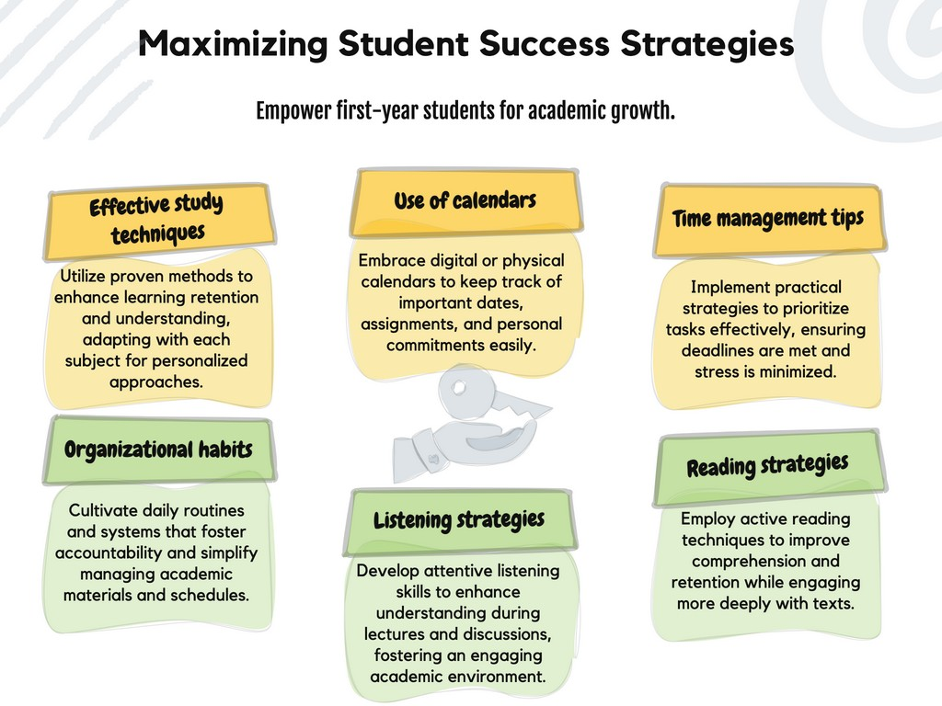
UMAK
Powerpoint Template
March 3, 2016

Slide 7
UMAK
Study Techniques
Quizlet
An interactive tool for creating flashcards and studying through games.
Anki
A spaced repetition system that enhances memory retention for long-term learning.
Brainscape
Uses cognitive science principles to boost study effectiveness.
Powerpoint Template
March 3, 2016

Slide 8
Time Management Apps
Forest
This app encourages productivity by allowing users to grow virtual trees as they concentrate.
Focus To Do
Combines the Pomodoro technique with task management for enhanced productivity. It requires manual input for task planning and focus sessions
RescueTime
Tracks time spent on tasks to identify productivity patterns and improve time management. It runs in the background, tracking time spent on apps/websites

Slide 9
Organizational Habits
Evernote
A note-taking app that helps students organize assignments, notes, and documents.
Trello
Visual project management tool that aids in tracking tasks and collaboration.
OneNote
Microsoft's note-taking solution that offers versatile formatting for organizing information efficiently.

Slide 10
UMAK
Using Calendars and Reminders Strategically
Google Calendar
A scheduling app that helps users manage events, set reminders, and sync across multiple devices for personal and professional planning.
Todoist
A task management app that enables users to create to-do lists, set deadlines, and track productivity with collaboration features.
Notion
An all-in-one workspace for note-taking, project management, databases, and collaboration, ideal for organizing tasks and information.
Powerpoint Template
March 3, 2016

Slide 11
Effective Reading and Listening Strategies
Speechify
A text-to-speech app that converts written content into natural-sounding audio, making it easier to listen to documents, articles, and notes.
Pocket
A reading app that lets users save articles, videos, and webpages for later viewing, even offline.
GoodNotes
A digital notebook designed for handwritten notes, PDF annotation, and document organization with a focus on Apple devices.

Slide 12
UMAK
Note Taking and Test Taking Skills
Notability
A versatile note-taking app that allows users to write, type, and annotate documents with audio recordings and multimedia support.
Microsoft OneNote A digital notebook with cloud syncing, enabling users to take, organize, and share notes with text, handwriting, and multimedia integration.
MindMeister
A mind-mapping tool for brainstorming, organizing ideas visually, and collaborating in real time.
Powerpoint Template
March 3, 2016

Slide 13
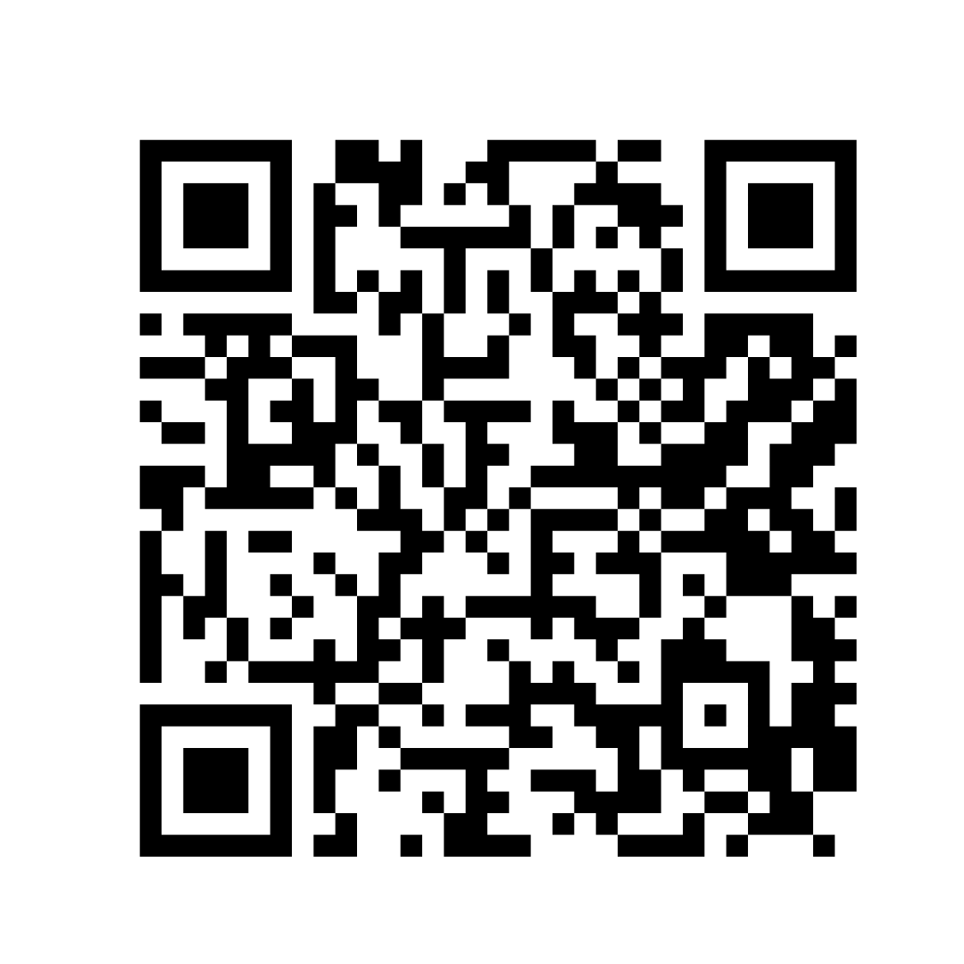
KEEP IN TOUCH!
Betsy Furler
betsy@forallabilities.com
Scan Here For Updates on SNaP ED Learning

