Slide 1
Deaf 101
Tiffani Riddick

Slide 2
Agenda
Introduction
The Basics
Communication
Tips on communication
Accommodations

Slide 3
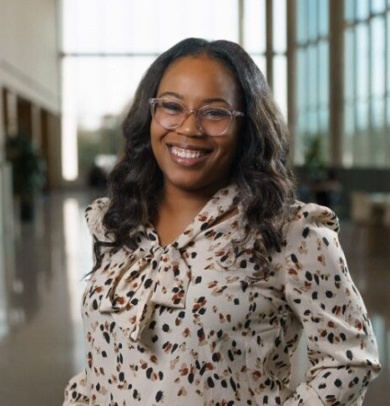
Introduction
A little about me…
My name is Tiffani Riddick.
Deaf and Hard of Hearing Coordinator.
Working at UT Arlington for 5+ years.
Fluent in ASL
Previously a sign language interpreter
Handle the Deaf/Hard of Hearing services and budget for students at UTA

Slide 4
I am not THE expert. My knowledge comes from my years of experience not only from working on the accommodations side of working with this population, but also from my previous experience in the classroom as an ASL interpreter.

Slide 5
The Basics
Hearing impaired: this is a term that is no longer used.
deaf: this is a general term used to describe people with a significant hearing loss.
Deaf: capital-D typically consider themselves a part of the Deaf community and identifies with Deaf culture.
Hard of Hearing: typically used for those that are late-deafened or someone with mild hearing loss to significant hearing loss; often have some spoken language.

Slide 6
Communication
Did you know…?
  American Sign Language (ASL) is derived from French Sign Language
  ASL is NOT universal. Most countries have their own sign language.
  ASL is not just the movement of your hands, but it is also important to use facial expressions and body movement
  ASL is not English. It is its own language. The grammar and the syntax is different.

Slide 7
Tips for interacting with students
Do not alter your speech pattern, instead, consider rephrasing.
​
Face the Deaf client or student when speaking.
Do not shout or over enunciate. Repeat questions asked from the back.​
But please note: lip reading is not 100% accurate. According to the National Association of the Deaf, even the most skilled lip readers can only understand about 25%.

Slide 8
Interacting with Students cont.
If you are unsure, text, use paper and pencil.​
Ask open-ended questions.​
It is okay to gently tap a deaf person to get his or her attention.​
Please alert the person to an emergency.​

Slide 9
Tips for interacting with an Interpreter
Speak directly to the student. Do not direct questions to the interpreter.​
  Do not say “tell/ask him/her”​
Allow the interpreter to be positioned in an area out of direct sunlight and away from a distracting background.​
In a classroom or presentation setting, be cognizant of “lag time” when asking questions.​
The Interpreter’s objective in the classroom is to facilitate communication for the Deaf/Hard of Hearing student- they are not teacher aids
In a group setting, please have one person speak at a time. Take turns so that the information is relayed effectively.

Slide 10
Classroom Accommodations
American Sign Language (ASL)
  Sign Language Interpreters
CART
  Communication access realtime translation
  Word for word
TypeWell
  Meaning-for-meaning translation
C-Print
  Captioning but provides a summary

Slide 11
In Conclusion…
It is best to ask your student what is their preferred form of communication, specifically in the classroom.
Glean/Otter/etc. are also captioning services that can be beneficial for some students.
Paper and Pencil are effective and appropriate communication in cases of emergency or last-minute options.

Slide 12
Questions?

Slide 13
Thank you
Tiffani Riddick
tiffani.riddick@uta.edu
www.uta.edu/sarcenter

