Slide 1


Slide 2





By Arianna Kandola, M.Ed
Ph.D. Candidate
Empowering Success:
THE IMPACT OF TECHNOLOGY ON STUDENTS WITH DISABILITIES

Slide 3





Agenda
  Introduction
  Review of Research
  Key Themes and Findings
  Strategies for Accessible & Engaging Online Learning
  Q&A

Slide 4
By the end of this session, participants will be able to:
  Analyze research findings on the academic and emotional experiences of postsecondary students with disabilities in virtual learning environments.
  Identify common challenges and barriers students with disabilities face in accessing and engaging with online education.
  Apply inclusive strategies and technology-based solutions to create more accessible, engaging, and supportive online learning experiences for students with disabilities.
Objectives

Slide 5


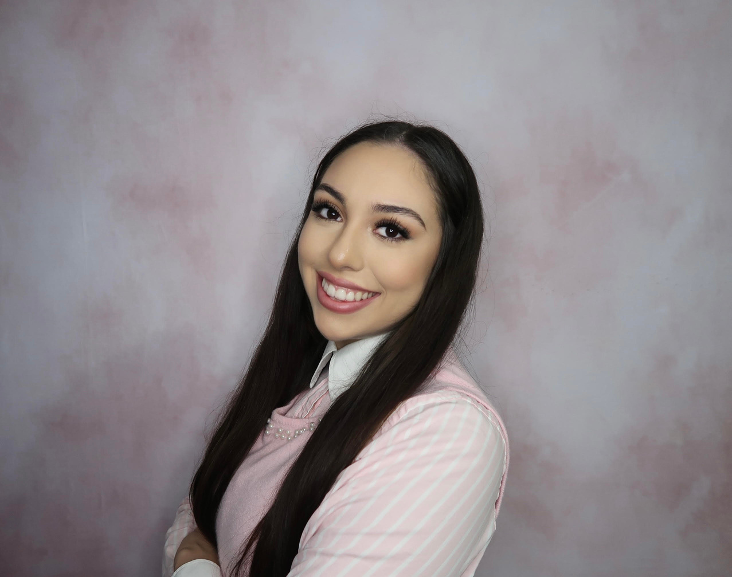
Introduction
👋 Hi everyone! I’m Arianna Kandola.
  Virtual Special Education Teacher
  Ph.D. Candidate in Special Education
  Research focus: The impact of instructional settings and technology on academic achievement for students with disabilities
🔹 Why This Topic?
  Technology can be empowering or limiting depending on how it’s implemented
  Students with disabilities have unique experiences in virtual education, and their voices matter
  My research explores how we can make online learning more accessible, engaging, and beneficial
👉 Today, I’ll share insights from recent research and discuss strategies to improve online education for students with disabilities.
Hi there! I’m Arianna!

Slide 6

WHY VIRTUAL EDUCATION?
💡 THE GROWING ROLE OF ONLINE LEARNING IN HIGHER ED
🎯 WHY THIS MATTERS:
  Online learning should enhance education, not create more barriers
  Students' academic success and well-being depend on effective implementation
  More students with disabilities are enrolling in online programs
  Accessibility & flexibility have both benefits and challenges

Slide 7
Study Focus
Participants
  Explored undergraduate students with learning disabilities navigating their first online semester during COVID-19
Research Spotlight
  6 Canadian students with LD in various degree programs
GEOGAN ET AL. 2023
Key Findings
Limitations
  "Hit or miss" experience – worked well for some, but others struggled
  Emotional overwhelm & fighting for accommodations
  Stigma & self-teaching – had to put in extra effort
  Small sample, only from one country

Slide 8
Study Focus
Participants
  Compared academic performance and accommodation access in online vs. in-person degree programs
Research Spotlight
  5,586 students in Biological Sciences program
  126 online students with disabilities
  232 in-person students with disabilities
MEAD ET AL. 2023
Key Findings
Limitations
  In-person students received more accommodations
  Online students with disabilities performed better academically
  Selection bias – students who preferred online may have performed better

Slide 9
Study Focus
Participants
  Investigated challenges in online learning for college students with disabilities
Research Spotlight
  113 students with various disabilities in Malaysia
MA’MOR ET AL. 2022
Key Findings
Limitations
  Benefits: Flexible, accessible, affordable
  Challenges: More distractions, less instructor engagement, higher stress
  Barrier: Parents lacked tech skills to support their children
  Region-specific findings

Slide 10
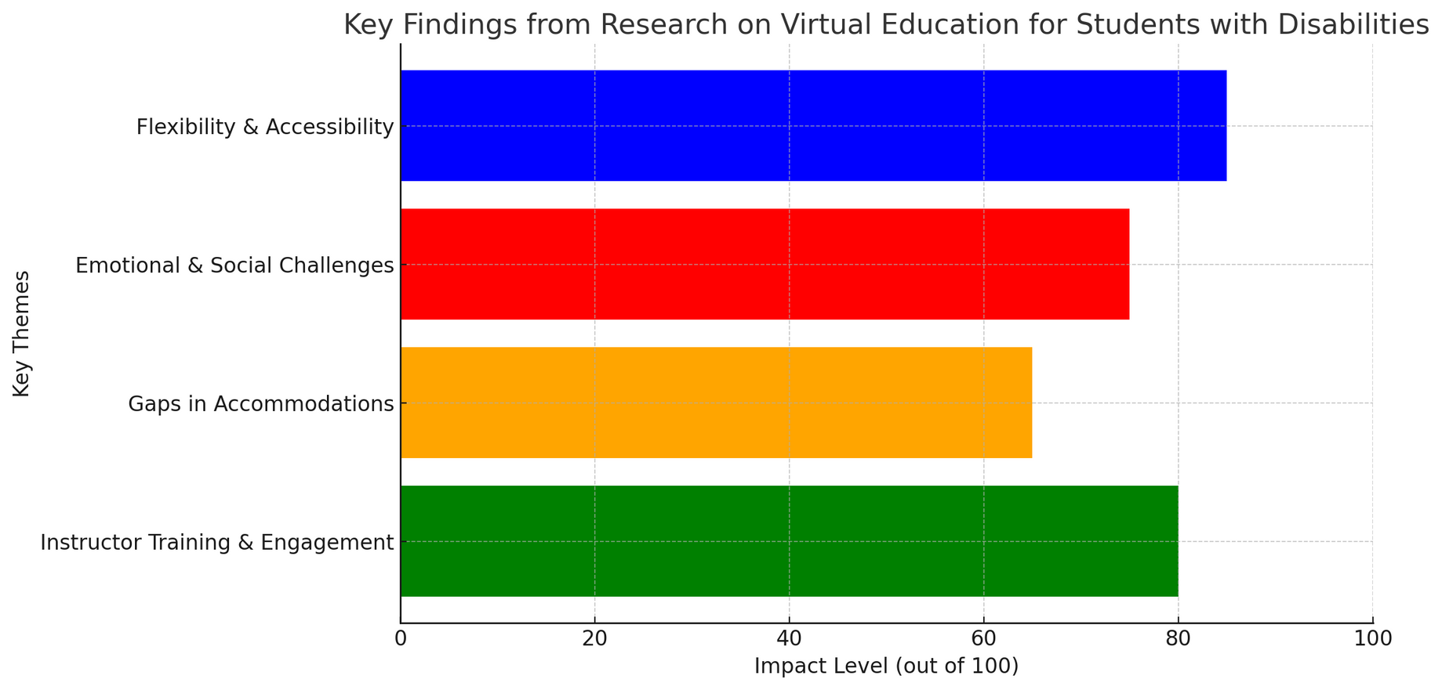
SYNTHESIS OF FINDINGS

Slide 11




IDEAS
💡 Given these insights, how can we improve online learning for students with disabilities?
Key Focus Areas:
✅ Accessibility
✅ Engagement
✅ Equity
➡️ Let’s discuss effective strategies!

Slide 12




FROM RESEARCH TO PRACTICE
🎯 UNIVERSAL DESIGN FOR LEARNING (UDL)
🛠️ ASSISTIVE TECHNOLOGIES
Strategies for Enhancing Accessibility
  Screen readers, captioning, text-to-speech
  Adjustable learning interfaces
  Multiple ways to present information
  Multiple ways for students to engage and respond
✅ Making Accommodations Available
& Easy to Access

Slide 13

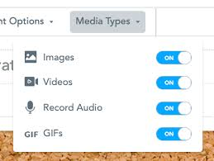

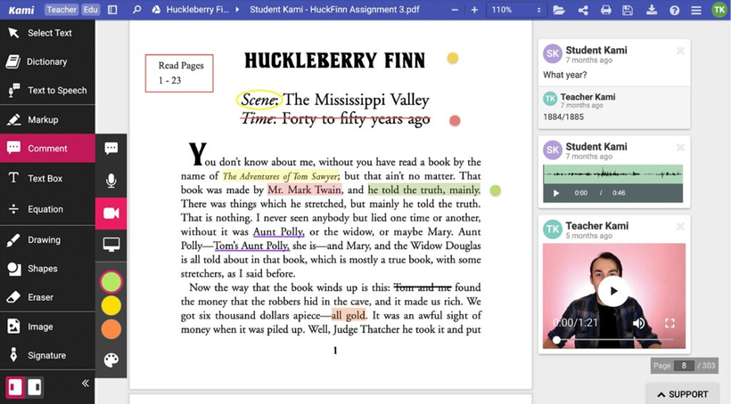
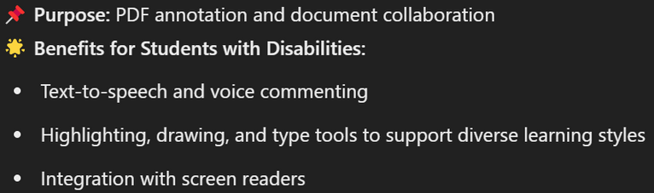
FROM RESEARCH TO PRACTICE
Strategies for Enhancing Accessibility

Slide 14


FROM RESEARCH TO PRACTICE
🎯 MULTIMODAL CONTENT
🎯 INTERACTIVE FEATURES
Engaging Online Learning Evironments
  Videos, infographics, transcripts for multiple learning preferences
  Live Q&A, breakout rooms, peer discussions
🎯 INSTRUCTOR TRAINING
  Faculty need professional development in accessible teaching

Slide 15
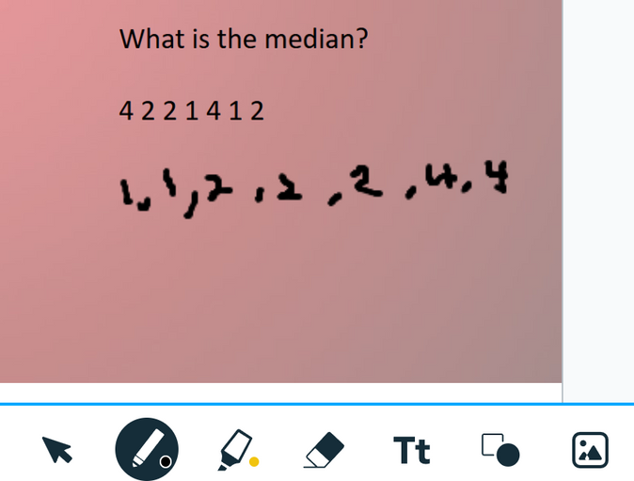
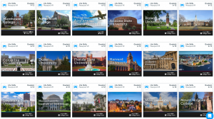
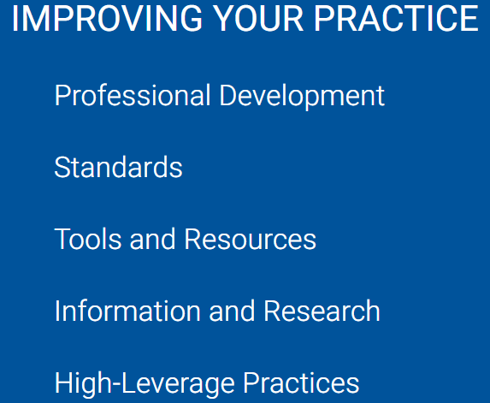

FROM RESEARCH TO PRACTICE
Engaging Online Learning Evironments

Slide 16

FROM RESEARCH TO PRACTICE
🧠 SUPPORT SYSTEMS
👥 COMMUNITY BUILDING
Addressing Emotional & Social Well-being
  Virtual office hours, peer mentoring, mental health resources
  Online spaces for peer connection & engagement
🔄 REGULAR FEEDBACK & ADAPTATION
  Checking in with students to adjust instructional methods

Slide 17
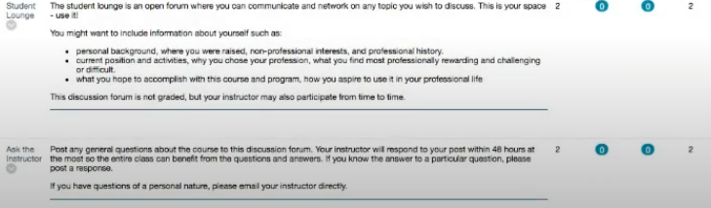
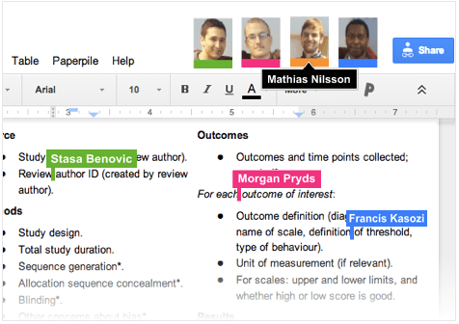
FROM RESEARCH TO PRACTICE
Addressing Emotional & Social Well-being

Slide 18
BEST PRACTICES AND FUTURE DIRECTIONS
📢 WHAT WE CAN DO MOVING FORWARD:
👀 FUTURE RESEARCH NEEDED:
✔️ More training for educators in online accessibility
✔️ Stronger policies on digital accommodations
✔️ Further research on long-term outcomes for students with disabilities in online
  Post-grad success of online vs. in-person students
  Long-term effects of online learning on social development

Slide 19
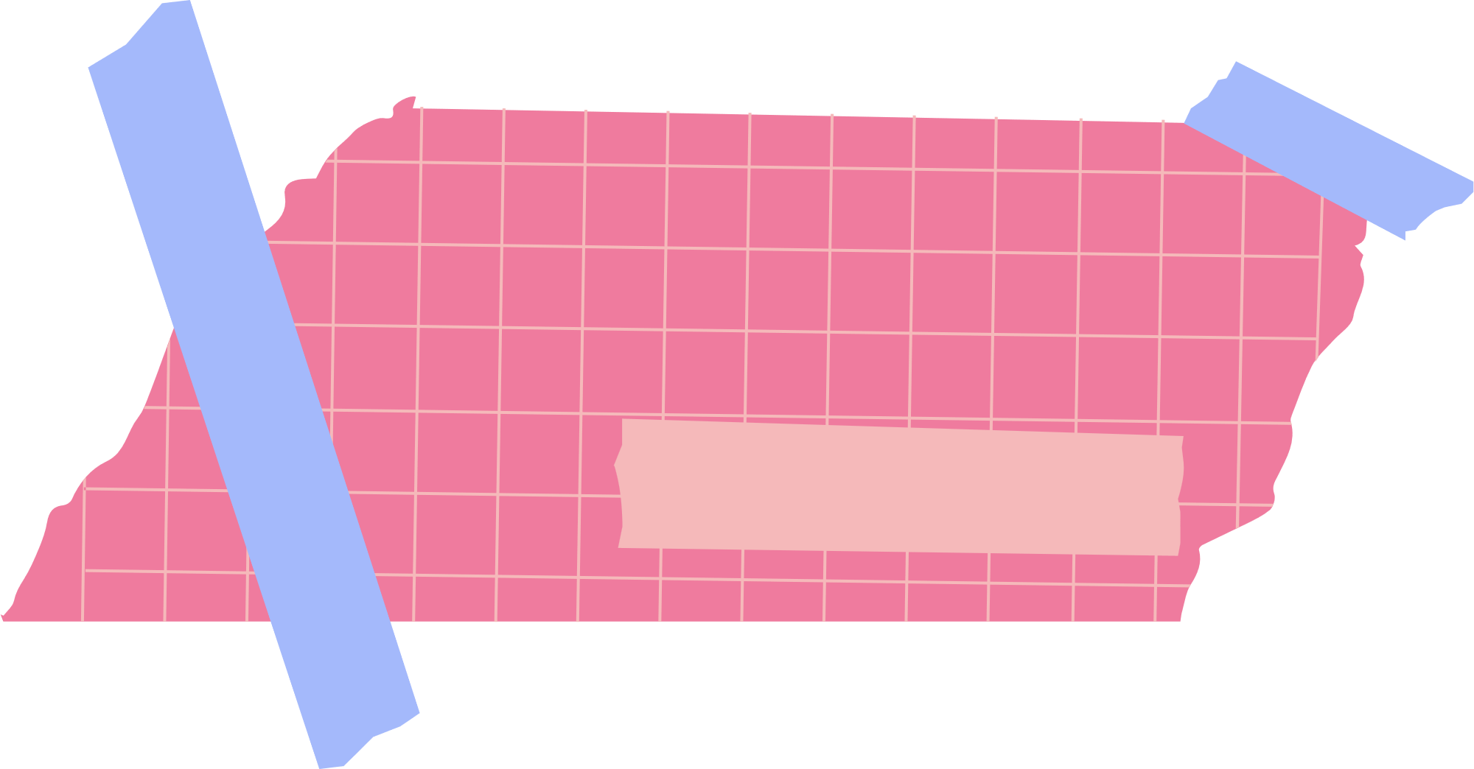

Take
📢 What will YOU do to improve online education for students with disabilities?
action!
✅ Online learning can be empowering—but only when designed intentionally
✅ We must listen to students with disabilities and adapt our approaches
✅ Accessible technology and instructor support are non-negotiable

Slide 20
💬 Questions? Let’s talk!
🔹 Open discussion—share your experiences!
Q&A / Discussion

Slide 21
THANK
YOU!
akandola@k12.com
www.linkedin.com/in/arianna-kandola-m-ed-94a9b4276
➡️ Let’s stay connected!

Slide 22
Nearpod: https://nearpod.com/ Kami: https://www.kamiapp.com/
Padlet: https://padlet.com/
Glean: https://glean.co/glean-institutional-pricing?utm_campaign=DSS%2FStudents%20-%20TOFU%20-%20Paid%20Search&utm_source=ppc&utm_medium=S1%202020%20B2C&utm_term=Glean&utm_content=glean_search&utm_term=glean&utm_campaign=S1+2020+B2C&utm_source=adwords&utm_medium=ppc&hsa_acc=5624956757&hsa_cam=11243717985&hsa_grp=112741631240&hsa_ad=634067984787&hsa_src=g&hsa_tgt=kwd-135693102&hsa_kw=glean&hsa_mt=b&hsa_net=adwords&hsa_ver=3&gad_source=1&gclid=CjwKCAjw-qi_BhBxEiwAkxvbkMMNGg5X17D6Y5Ia1ad3QyGULUwfR98Otlu_gmyisNpwox-2c6QHjxoCJ3QQAvD_BwE
Council for Exceptional Children PD: https://exceptionalchildren.org/improving-your-practice/professional-development Otterai: https://otter.ai/home

