Slide 1
AHEAD in TX 2023
professional
IDENTITY
By Design, Not Default
ERIN JUSTYNA, Ph.D.
Notes:
Introduce me, TTU 20+ years, Associate Provost TTUHSC Since September 2019.
Why this topic? CARS & NACADA What does it mean to be a professional?

Slide 2
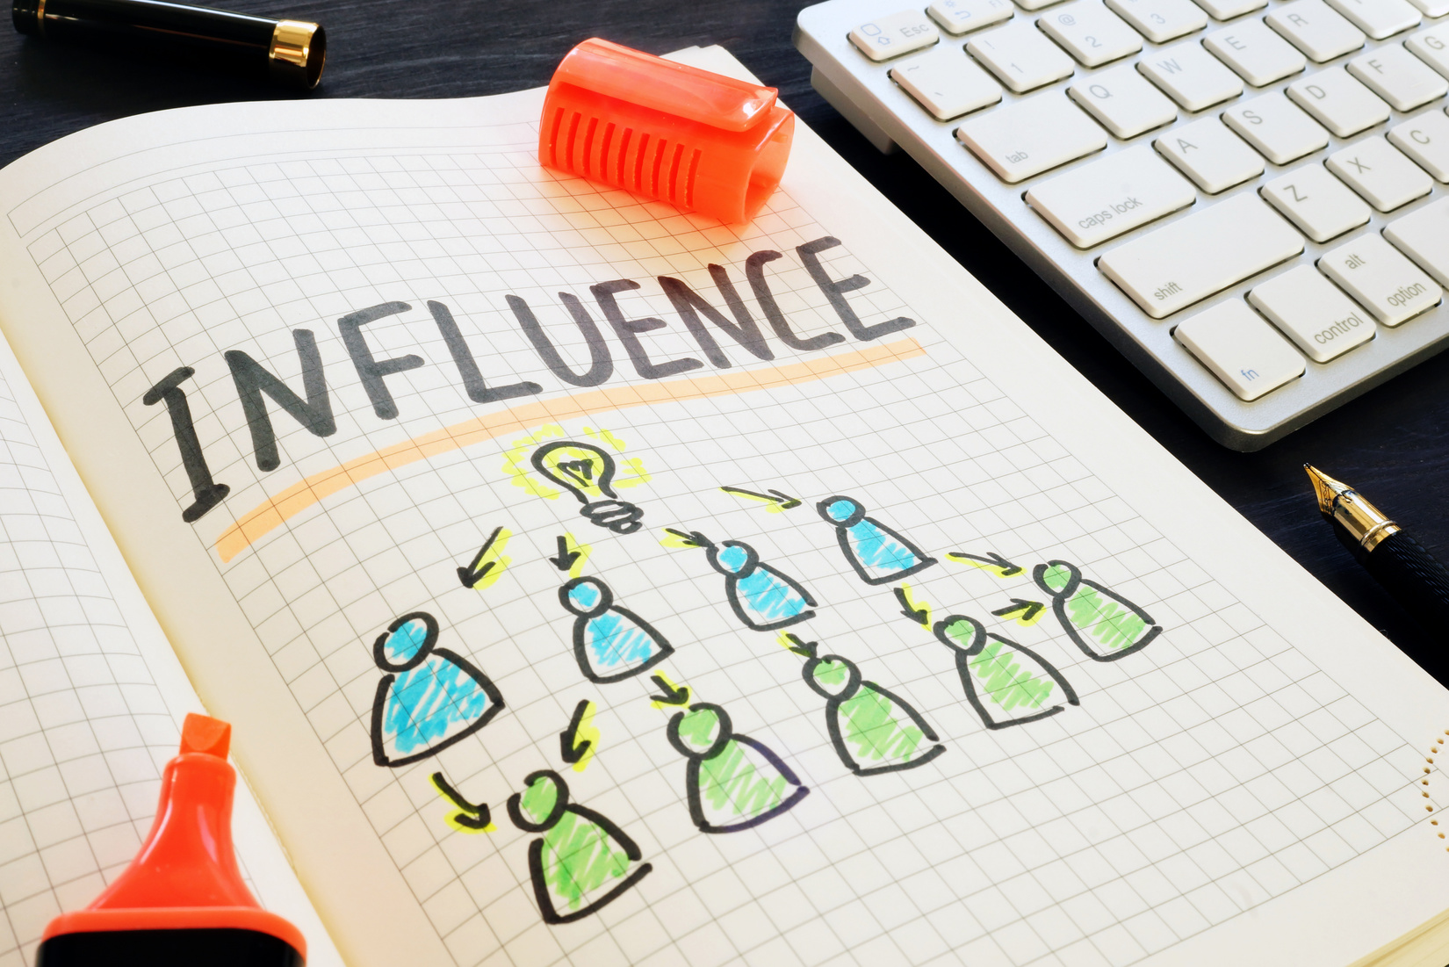
10,000
You will influence more than 10,000 people in your lifetime. Every day, you influence others,
Maxwell, J. (1993). Developing the leader within you.
Notes:
10,000 – According to John Maxwell (1993), author of Developing the Leader Within You, even the most introverted individual will influence 10,000 people in their lifetime. Think about that! That’s amazing.
· What do you want your impact to be? (on colleagues, students, vendors)
· Have you thought about it?

Slide 3
AHEAD in TX 2023
BY DESIGN
GOALS
Individuals who develop a strong professional Identity will design a career with greater impact and purpose.
Describe professional identity
Understand the importance
Assess own professional identity
Create a plan for development
ERIN JUSTYNA, Ph.D.

Slide 4
the
RESEARCH
Professional identity is based on social roles/group membership, as well as personal & character traits you display/others attribute to you (Ibarra, 1999).
TTUHSC
"Professional identity is not a stable entity; it is complex, personal, and shaped by contextual factors" (Clarke, Hyde, & Drennan, 2013, p. 8).
Notes:
First, let’s explore what is meant by the term professional identity.
What do we know about professional identity? The research is pretty sparse. There is some literature regarding the topic for counselors, teachers, nurses - mostly fields with very specific certification- but the rest of us? Not so much.
● Most scholars agree that professional identity refers to the various meanings attached to a person by themselves and others.
○ It’s based on your social roles and group memberships, and personal and character traits you display and others attribute to you. It’s constructed and negotiated in social interaction (Ibarra, 1999).
○ So, professional identity isn’t a stable entity, it’s “complex, personal, and shaped by contextual factors" (Clarke, Hyde, & Drennan, 2013, p. 8).
As students and professionals at TTUHSC our brand is influenced by and, in turn, influences the HSC brand.

Slide 5
Role
ADAPTATION
Observe role models
Experiment with provisional selves
Evaluation experiments against internal standards and external feedback
(Ibarra, 1999)
Notes:
Herminia Ibarra’s work suggests that we go through a three-step process of role adaptation. We:
● Observe various role models to identify potential identities.
● Experiment with provisional selves.
● Evaluate experiments against internal standards and external feedback. (Ibarra, 1999, p. 764)
Chat: I appreciate others who….three qualities or behaviors
(I appreciate others who, I’m powerful when)

Slide 6
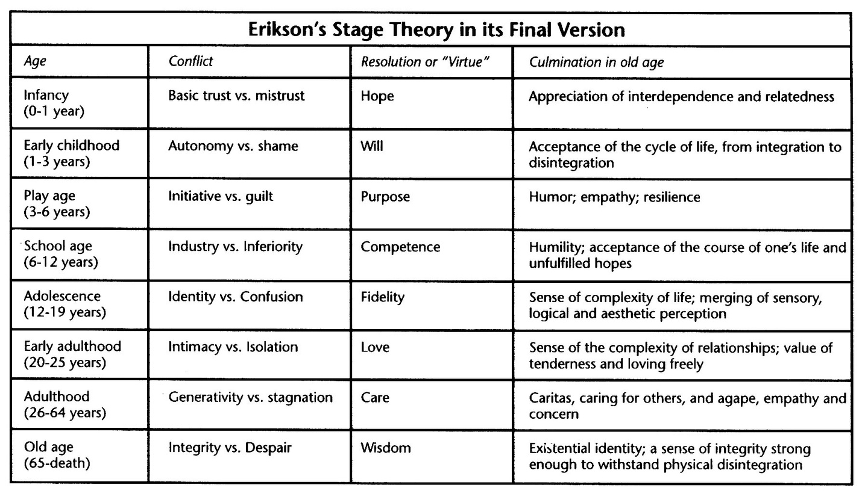
ERICKSON'S IDENTITY THEORY
www.learningtheories.com
Notes:
Another way to consider our professional identities is to consider Erik Erikson’s psychosocial development stage theory. Each stage of development comes with its own unique crisis.
Outline stages briefly
We can think about how that relates to our time in our professional careers/current position.
● From 0-1 year, you are trying to get a sense for who and what you can trust. You’ll leave this stage with either a feeling of faith in your surroundings or suspicion.
● From year 1-3, you will either gain autonomy and feelings of adequacy or you may begin to experience shame and self-doubt.
● In year 3-5, you’ll begin to either take initiative or perhaps feel guilty about not doing so.
● Years 5-12, you’ll gain a sense of competency or feel inferior.
● And so on, all the way through the care and wisdom years, when you will truly give back to your profession and leave some sort of legacy.
Poll: Where do you fall?
How has the pandemic affected this? Relearning, confidence, social aspects.

Slide 7
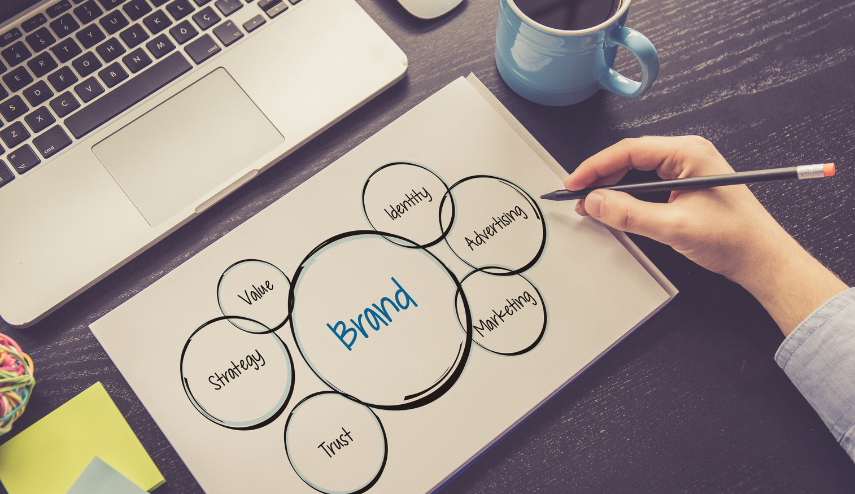
personal
BRAND
“Personal branding is about managing your name — even if you don’t own a business — in a world of misinformation, disinformation, and semi-permanent Google records. Going on a date? Chances are that your “blind” date has Googled your name. Going to a job interview? Ditto.”
Tim Ferriss
Professional identity = Personal Brand
Notes:
Now that we have a sense of what is meant by professional identity, let’s talk about why it is so important to develop a strong professional identity
Professional Identity = Personal Brand
As individuals, we have great power over the meanings that are attached to us by ourselves and others. We can either actively create our identity or allow others to do it for us.
Share: How I ended up at SDS

Slide 8
PROFESSIONAL IDENTITY DEVELOPMENT
Talents/
Strengths
Values
Brand
Notes:
A powerful metaphor I’ve used to consider my professional identity is branding. My professional identity is in essence my personal brand. I have to define my brand, manage my professional identity, and seek feedback.
Activity: Favorite brands?
What do your favorite brands portray? Slogans, known for, how they make you feel?
Define your brand (values, talents/strengths)
Chat: Share your brand (and the why [your key values & talent])).
Share mine – Human Potential Maximizer
A strong professional identity provides purpose and satisfaction
Without a strong professional identity, it becomes easy to fall into a mode of default.

Slide 9
design
NOT DEFAULT
A strong professional identity provides purpose and satisfaction. Without a strong professional identity, you may be acting in default mode.
Yes or no
To do list/calendar
Thornton, H. (2013). Living and working by design, not by default.
Notes:
You can either operate by design, meaning that you put specific measures in place to keep you energized, self-aware, and operating at full capacity. or you can operate by default, doing what seems comfortable or easy in the moment.
As I spoke about earlier, I had been in a mode of default. I am certainly not alone.
I’ve found a great way to think about this is to consider whether I am working from a place of design or default in regard to my priorities.
● Default – Say YES to everything! Do what’s important to others; ignore what’s important to YOU (Thornton, 2013)
● Design – Learn how to say NO. Say YES to activities that support your goals and priorities. Say, “Let me think about that and check my schedule,” before saying YES or NO. Keep in mind that every YES is a NO to something else (Thornton, 2013)
● Default – Wake up each morning and see what happens! Rely on your memory for everything. Don’t schedule anything. Or, schedule too much. Procrastinate doing little tasks until they become large, overwhelming projects. Spend all your time putting out fires, real and imagined. (Thornton, 2013)
● Design – Keep a master to-do list. Schedule regular blocks of time for projects that are important to you. Plan each day the night before and have weekly and monthly planning sessions with yourself. Set S.M.A.R.T. Goals. Leave some slack for emergencies, downtime, and opportunities. (Thornton, 2013)

Slide 10
DEFAULT
It's easy to get lost, and wake up many years later in a strange land asking yourself, "Who am I, how did I get here, and how do I get back?"
Todd Henry
Notes:
"It's easy to get lost, and wake up many years later in a strange land asking yourself, ‘Who am I, how did I get here, and how do I get back?’” Todd Henry
How has the pandemic affected our commitment to our values and priorities?

Slide 11
BY DESIGN
With a strong professional identity, you can seek out/choose activities and make decisions that align with your values/purpose/brand.
empowering
challenging
Inspiring
Notes:
With a strong professional identity, you can seek out/choose activities and make decisions consistently and in alignment with your values/purpose.
● Empowering – taking control of your identity puts you in the driver’s seat.
● Challenging – facing your fears pushes you past previously imposed limits
● Inspiring – people are watching (and modeling).
Remember you are influencing 10,000 people!

Slide 12
consistent
PRACTICE
The only way to avoid getting off track or burned out is to be mindful and engage in consistent practices that keep you on the path you design.
(Toddy Henry, 2013)
Notes:
It can be really challenging to sit down and design your personal brand. It’s likely you’ve never considered yourself in this way. And then, once you’ve decided what you want your brand to be, you still have to reflect on the current state of your professional identity and make continual choices that align your image and actions with the values and strengths of that brand.
The only way to avoid getting off track or burned out is to be mindful and engage in consistent practices that keep you on the path you design (Henry, 2013).
Consider whether you have been focused on your values and purpose in your activities, your image, and your professional network.

Slide 13
TRADITIONAL
MODERN
What you say (and how)
Non-verbals
Actions
Network
Professional and personal fused
Social media
Professional sites
Not just you - those with whom you associate

Slide 14
take a
LOOK
Thorough assessment highlights needed action.
colleagues
calendar/task
Social Media
students
Resume/CV
task List
Notes:
Look at your calendar and task lists - where is your time going. Remember any yes is a no to something else.
Pull up your resume/CV. Has your career path been what you what? Has it been intentional? To what presentations, publications, etc. have you been giving energy and time?
Have you participated in enough/the right professional development activities?
“Google” yourself – this is what others are seeing in your digital identity. What do the results of your search say about your brand?
LinkedIn, Facebook, Twitter, etc. - Do you have these? Do you keep them up to date? Do they align with the image you want to portray?
● This is not about being fake, but about being mindful.
○ Example of Instructor talking about student/students complaining & political divisiveness vs. professional highlighting relationships with colleagues.
Seek out and just listen – feedback is everywhere!
The true measure of your brand is the reputation others hold of you in their hearts and minds. Notice how they introduce you to others.

Slide 15
TAKING STOCK
what's going well?
What needs Work?
What's missing?
Notes:
Take stock of what is good, what needs work, and what you might be missing, and then create a concrete action plan that includes ways to hold yourself accountable.

Slide 16
prof dev
RESOURCES
There are many resources available to support your professional identity development:
PROFESSIONAL ORGS
CAMPUS resources
Mentors
Networking
reading - books & Web
coaches
Notes:
There are many resources available to support your development of professional identity
· Campus resources - short courses, training, special events, student events
· Professional Organizations
· Professional Presentation/Publication
· Formal/Informal Networking/Mentoring
· Reading/Internet surfing
See “Stretch Activities”
Seek out those with similar brands/values and those who have aspects you want to emulate (e.g., porch sitting, monthly prof dev happy hour)

Slide 17
AHEAD IN TEXAS 2023
DEFINE THE PLAN
Avoid comfort & focus on the future
Within 1 year
Within 6 months
FOCUS
Within 3 months
Within 1 month

Slide 18
practice
INTENTIONALITY
Show up
Own up
Straighten it up
Who will hold you accountable?
(Booher, 2011)
Notes:
Show up, own up, straighten it up – (Booher, 2011, p. 173)
● Don’t whine
● Admit mistakes
● Track progress & make it visible
● Be accountable for results
"Being a professional is doing the things you love the days you don’t feel like doing them.” Julius Erving, Basketball Hall of Famer
Accountability Measures
“colleagues, supervisor, mentor, me!

Slide 19
ahead In texas 2023
if you don't define your brand,
someone else will
Erin Justyna, Ph.D.
erin.justyna@ttuhsc.edu
www.ttuhsc.edu/student-affairs

Slide 20
References & Reading
Booher, D. (2011). Creating personal presence: Look, talk, think, and act like a leader. San Francisco, CA: Berrett-Koehler Publishers.
Braun, A. (2014). The promise of a pencil: How an ordinary person can create extraordinary change. New York, NY: Scribner.
Clarke, M., Hyde, A., & Drennan, J. (2013). Professional identity in higher education. In The academic profession in Europe: New tasks and new challenges (pp. 7-21). Netherlands: Springer.
Dweck, C. (2008). Mindset: The new psychology of success. New York, NY: Ballatine Books.
Henry, T. (2013). Die empty: Unleash your best work every day. New York, NY: Penguin.
Henry, T. (2011). The accidental creative: How to be brilliant at a moment's notice. New York, NY: Penguin.
Ibarra, H. (1999). Provisional selves: Experimenting with image and identity in professional adaptation. Administrative Science Quarterly, 44(4), 764-791.
Erickson’s stage of development. (n.d.). Retrieved from https://www.learning-theories.com/eriksons-stages-of-development.html
Marshall, K. (2015, January 5). How to Curate Your Digital Identity as an Academic. The Chronicle of Higher Education. Retrieved from http://www.chronicle.com/article/How-to-Curate-Your-Digital/151001/
Maxwell, J. (1993). Developing the leader within you. Nashville, TN: Thomas Nelson, Inc.
Nugent, F.A. & Jones, K.D. (2009). Introduction to the profession of counseling (5th ed.). Upper Saddle River, NJ: Pearson.
Pink, D. (2009). Out of our minds: Learning to be creative. New York, NY: Penguin Group.
Robinson, K. (2011). The element: How finding your passion changes everything. Oxford, England: Capstone.
Stoddard, D. (2003). The heart of mentoring: Ten proven principles for developing people to their fullest potential. Colorado Springs, CO: NavPress.
Thornton, H. (2013). Living and working by design, not by default. Organized for Life: Less Clutter. More Life. Retrieved from http://www.org4life.com/living-and-working-by-design-not-by-default/
Woo, H.R. (2013). Instrument construction and initial validation: Professional identity scale in counseling (PISC). (Doctoral dissertation). Retrieved from Iowa Research Online. http://ir.uiowa.edu/etd/2663.

