Slide 1
Challenging Engrained Ableist Practices in Higher Education
Jessica N. Stone, Director Office of Disability Access – University of North Texas Brenda E. Avilés, ACCESS District Advisor Collin College

Slide 2
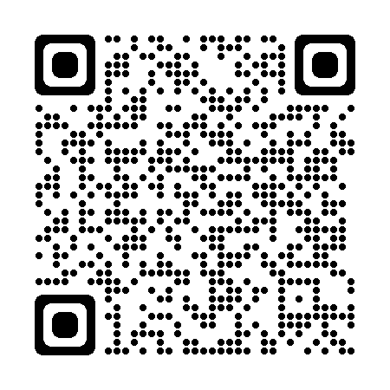
Welcome! Please feel free to scan this QR code to access our presentation.
Presentation
Full URL: https://tinyurl.com/AHEADTXAbleism

Slide 3
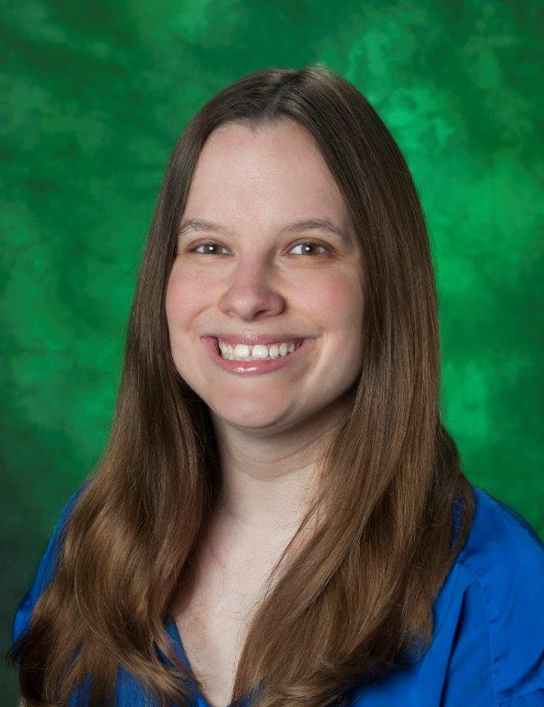
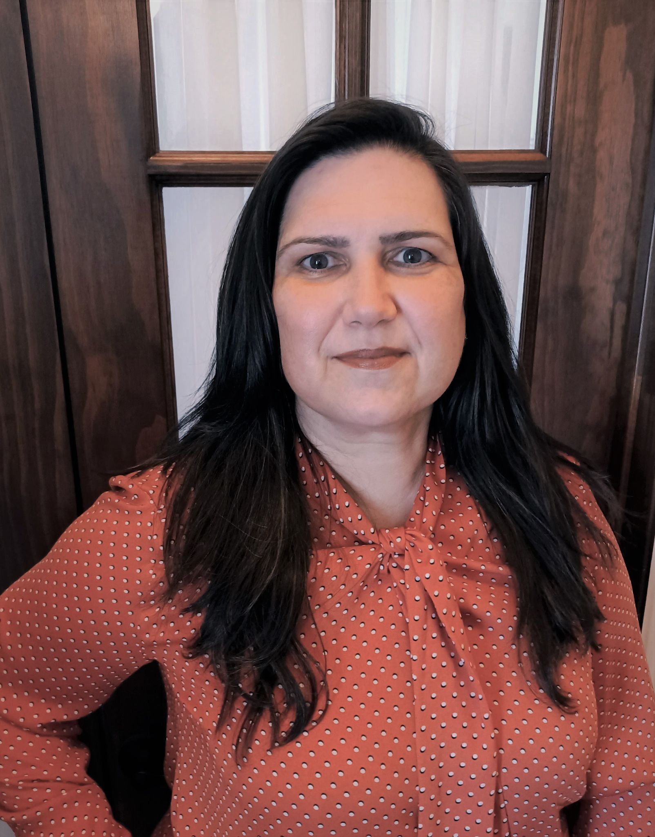
Presenter’s Positionality
We feel that our positionality allows us a unique perspective on the themes discussed. We view them from our lenses as disabled women.
Jessica N. Stone, M.S. CRC, LPC
Director – Office of Disability Access
University of North Texas
Brenda E. Avilés, M.B.A.
ACCESS District Advisor - Disability Services
Collin College
(she, her, hers)
Blind, White, Higher Education Professional, Doctoral Student, and Mother
(she, her, hers, ella)
Puerto Rican, deaf/hearing loss, Higher Education Professional, Doctoral Student, and Mother

Slide 4
Accessible Guidelines
Please raise your hand.
Speaking?
When beginning to speak, please say your name.
Questions?
Make a verbal comment such as “I have a question”.
Speak clearly at a comfortable pace.
Understand that a CART provider is transcribing word for word. Please note that this may cause a delay in response time, and you may be asked to repeat your question.

Slide 5
WHAT IS ABLEISM?
Let’s be transparent…
/ˈābəˌliz(ə)m/
*** Audience Participation ***

Slide 6
Key Terms and Definitions
Ableism
Persistent conscious and unconscious devaluing of disability. Disability is understood as an inherently negative state of being, whereas able-bodied and able-minded individuals are favored (Campbell, 2009).
Academic Ableism
Dolmage (2017) argued that higher education promotes ableism more than most cultural institutions do.
Academic ableism includes unwelcoming attitudes rooted in stigma from faculty, staff, and peers (Barragan & Nusbaum, 2017).
Disabled students experience academic ableism differentially depending on their disabilities and other social identities (Miles et al., 2017).

Slide 7
Key Terms and Definitions
(Cont.)
Disability, disabled, dis/ability, (dis)ability
Disabilities are often metaphors for weaknesses or limitations (Schalk, 2013).
(Un)spoken norm where differences or disabilities are viewed as abnormal (Annamma et al., 2013).
Society dis/ables many people (Kliewer, Biklen, & Kasa-Hendrickson, 2006).
“provides unique ways of understanding the world” (Annamma, Connor & Ferri 2013b).
Social identity for many people.

Slide 8
Oppressive (Un)spoken Norms
(Annamma et al., 2017)
Often, when used in everyday discourse, disabilities are metaphors for weaknesses or limitations (e.g. "Blind eye", "deaf to the argument“).
"Ableist language perpetuates non-recognition" and "perpetuates normative strategies of erasure” (p.154)
(Un)spoken is meant to capture both specifically expressed and hidden norms."

Slide 9
WHY IS IT IMPORTANT TO RECOGNIZE ACADEMIC ABLEISM?
Ableism often goes unnoticed, unchecked, and unchallenged…

Slide 10
The “Why”
Students with Disabilities (SWD)--- growing population: 19.4% of students enrolled in postsecondary education reported a disability in 2016 (Snyder et al., 2019).
Ableism shapes every aspect of our work in higher education, from the moment a student begins the application process to graduation.
Decades after the passage of the ADA, higher education still struggles to shift campus culture to one of equal access.
According to research from the NCES (2022), only 37% of high school students receiving accommodations apply for services at college.
We need to cultivate equitable and inclusive experiences for all, not just the disabled community.
Example: having flexible furniture is both ADA-compliant and equitable. Such a classroom is accessible not only to wheelchair users but to anyone, regardless of body size, and gives all students a chance to choose where in the room they want to sit comfortably.

Slide 11
The “Why” (cont.)
Ableism advantages non-disabled people and centers their experiences, requiring additional labor to identify and remove barriers systemically.
Ableism may also be manifested in accessibility efforts by “prioritizing” certain disabilities.
Stigma remains rampant: ableism creates a negative campus climate; it isolates and prevents college students from disclosing their disabilities.
Language reflects our values: practice sensitivity by eliminating the use of euphemisms (including “special needs”), negative connotations of pity, deficits, burden, needy, costly, etc.
Research: some students compare this additional labor as having additional workload comparable to a part-time job (Hannam-Swain, 2017).

Slide 12
Intersectionality
Minoritized groups/low socio-economic groups: additional hoops and barriers.
Understand disability from a cultural perspective with disability justice tenets, rather than a legal and medical one (Berne et al., 2018).

Slide 13
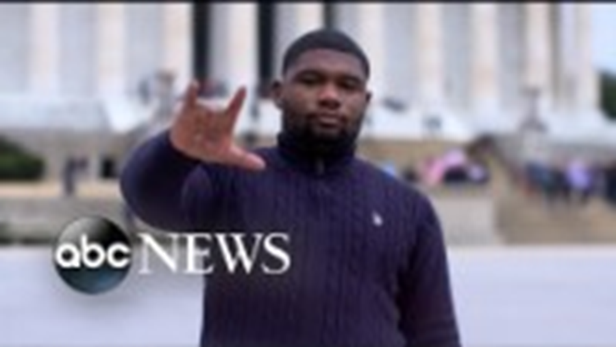
A few minutes to illustrate this…
Celebrating and Preserving Black American Sign Language (BASL)
https://www.youtube.com/watch?v=eyCdz3Y_EdI

Slide 14
Ableism on Campus

Slide 15
What are some examples of ableism that you have encountered on campus?
*** Audience Participation ***
Words or concepts
Structures, Architecture, and Spaces
Policies, Processes, and Requirements
Classroom Instruction and Pedagogical Strategies
Resources
Attitudinal
Cultural

Slide 16
What are some examples of ableism that you have encountered on campus? (cont.)
Systematic inconsistencies across campus due to repeated inflexibility, inaccessibility and exclusion: shifts in levels of accessibility also creates shifts in feeling (un)welcomed and (un)valued.
Example: location of wheelchair accessible ramps, flashing fire alarm for the d/Deaf, availability of voiced signals/audible cues in crosswalks

Slide 17
Institutional ableism: are you encouraging or hindering equal access?
*** Audience Participation ***

Slide 18
Institutional ableism: are you encouraging or hindering equal access? (cont.)
Frameworks & Mindsets in Disability Services
“strict compliance”
“spirit of the law”
“restless reflexive” (Jain, 2020; Titchkosky, 2011)
*** Audience Participation ***

Slide 19
ALTERNATIVE WAYS OF CONCEPTUALIZING DISABILITY

Slide 20
How can we identify alternative ways of conceptualizing disability to…
reject dominant discourses embedded in academic ableism?
*** Audience Participation ***

Slide 21
Engaging in a critical reflective process (Dei, 2005) to (re)think and (re)design our roles in adopt fluid dynamic nonlinear processes and policies to reshape our campuses.
Avilés, B. E., Bailey, M., Hernández-Saca, D.I., Karpicz, J. R., & Rivera-Singletary, G. (2022). Integrating equity-minded pathways in higher education. In B. Kinyanjui (Ed.), Disability and accommodations in higher education: A handbook for disability advisors. New York: BN Press.

Slide 22
How can we identify alternative ways of conceptualizing disability to…
take collective accountability?
*** Audience Participation ***

Slide 23
Making disability visible by recognizing that “positionalities are intersectionality unique” (Boda et al., 2022, p.10).
Centering disability and accessibility in your work. When “disability becomes central within the dialogue rather than existing on the sideline of presumed incompetence” (Dickens & Pearson, 2021,p. 82), we are cultivating a sense of belonging and community care.
“Operate from a perspective of culture of access, instead of making accommodations the sole responsibility of disabled people” (Miles et al., 2017).

Slide 24
Brief Pause
We welcome you to utilize this brief pause in whatever way is most helpful for you. Feel free to step out if you need. During this pause, we welcome any questions you may have. This is also a good opportunity for an intentional pause for reflection.

Slide 25
Reimagining Ableism Activity
What words starting with “A” can you think of that we can use to re-imagine ableism on a college campus?
Possibly words that describe how can YOU re-envision the future of access and true inclusion?
*** Audience Participation ***

Slide 26
Reimagining Ableism Activity (cont.)
Do not let a lack of imagination or empathy limit your work.
Be open to genuinely outlining a barrier or problem.
Be willing to learn something new about someone else’s accommodation needs instead of being stuck in “this is the way we have always done it”, and interrogate traditional ways of doing and normative ableist assumptions to shift towards “what if”.

Slide 27
Conclusion: Challenge!
Thank you for attending our session today!
What is one fact or practice you learned that you can take back to your role?
How can you reject dominant practices and discourses embedded in academic ableism while advocate for change?
What will you do to inform your language to resist hurtful implicit assumptions from underlying marginalized ideologies?
What processes or activities do you do just because "that's how you've always done it," that might be ableist?

Slide 28
References
ABC News. (2021, February 17). Celebrating and preserving Black American Sign Language. Live Prime. https://youtu.be/eyCdz3Y_EdI
Annamma, S. A., Jackson, D. D., & Morrison, D. (2017). Conceptualizing color-evasiveness: Using dis/ability critical race theory to expand a color-blind racial ideology in education and society. Race Ethnicity and Education, 20(2), 147-162. https://doi.org/10.1080/13613324.2016.1248837
Avilés, B. E., Bailey, M., Hernández-Saca, D.I., Karpicz, J. R., & Rivera-Singletary, G. (2022). Integrating equity-minded pathways in higher education. In B. Kinyanjui (Ed.), Disability and accommodations in higher education: A handbook for disability advisors. New York: BN Press.
Berne, P., Morales, A. L., Langstaff, D., & Invalid, S. (2018). Ten principles of disability justice. WSQ: Women's Studies Quarterly, 46(1), 227-230.Barragan, E., & Nusbaum, E. A. (2017). Perceptions of disability on a postsecondary campus: Implications for oppression and human love. Negotiating disability: Disclosure and higher education, 39-56. https://doi.org/10.1353/wsq.2018.0003
Boda, P. A., Nusbaum, E. A., & Kulkarni, S. S. (2022). From ‘what is’ toward ‘what if’ through intersectionality: problematizing ableist erasures and coloniality in racially just research. International Journal of Research & Method in Education, 1-14. https://doi.org/10.1080/1743727X.2022.2054981
Dei, G. J. S. (2005). Chapter one: Critical issues in anti-racist research methodologies: An introduction. Counterpoints, 252, 1-27. https://www.jstor.org/stable/42978742
Dickens, B. & Pearson, H. (2021). (Re)framing qualitative research as a prickly artichoke: Peeling back the layers of structural ableism within the institutional research process. In Lester, J. N. & Nusbaum, E. A. (Eds.), Centering diverse bodyminds in critical qualitative inquiry (pp. 81-94). Routledge.
Dolmage, J. (2017). Academic ableism disability and higher education. University of Michigan Press. https://library.oapen.org/handle/20.500.12657/47415
Hannam-Swain, S. (2018). The additional labour of a disabled PhD student. Disability & Society, 33(1), 138-142. https://doi.org/10.1080/09687599.2017.1375698
Kliewer, C., Biklen, D., & Kasa-Hendrickson, C. (2006). Who may be literate? Disability and resistance to the cultural denial of competence. American Educational Research Journal, 43(2), 163-192. https://doi.org/10.3102/00028312043002
Miles, A. L., Nishida, A., & Forber-Pratt, A. J. (2017). An open letter to White disability studies and ableist institutions of higher education. Disability Studies Quarterly, 37(3). https://dsq-sds.org/article/view/5997/4686
Schalk, S. (2013). Coming to claim crip: Disidentification with/in disability studies. Disability Studies Quarterly, 33(2). https://doi.org/10.18061/dsq.v33i2.3705
Titchkosky, T. (2011). The question of access: Disability, space, meaning. University of Toronto Press.

Slide 29
Thank You!
We’d love to continue this discussion!
Please feel free to email us with any questions/concerns!
Jessica Stone, Director at UNT: Jessica.Stone@unt.edu Brenda E. Avilés, ACCESS District Advisor at Collin College: BEAviles@collin.edu

