Slide 1

VOCATIONAL REHABILITATION SERVICES (VRS):
WHAT YOU NEED TO KNOW

Slide 2
SCOPE OF PRESENTATION
Vocational Rehabilitation Services
What you need to know
    Who we serve
    Example of Services
    Eligibility Criteria for services
    How to get started
    Assisting College Students
    Academic goals
    Career goals
    Questions

Slide 3
Texas Workforce Solutions
Texas Workforce Commission
28 local workforce development boards, and service-providing partners, community partners and four TWC unemployment benefits Tele-Centers.
Together Texas Workforce Solutions provides workforce education, training and support services, including vocational rehabilitation (VR) assistance for the people and businesses of Texas.

Slide 4
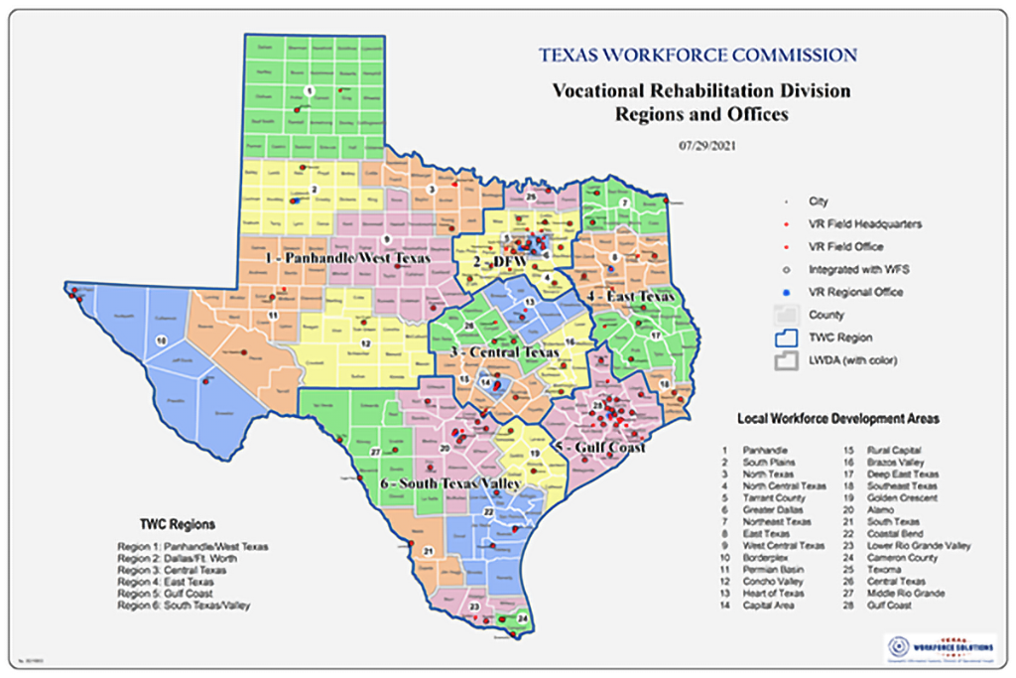
TWC Map

Slide 5
Vocational Rehabilitation
Services
A division within the Texas Workforce System.
A federal-state program that supports eligible adults and students with cognitive, medical, physical or visual conditions prepare for, find, retain or advance in employment.
Helps businesses and employers recruit, retain and accommodate employees with disabilities.

Slide 6
What you need to know

Slide 7
Who We Serve
Vocational Rehabilitation Services supports:
Eligible individuals with disabilities seeking employment
The business community
Building relationships allows us to:
Determine the training/skills needed to be a qualified applicant and better educate our customers about labor market needs.
Both are equally important and it’s our job to assist in their linkage.

Slide 8
A few examples of types of disabilities we serve
People with blindness and significant visual impairments
Hearing impairments, including deafness and hearing loss
Mental and behavioral health conditions
Physical disabilities, such as birth defects, back injuries or spinal cord injuries

Slide 9
More examples of types of disabilities we serve
Traumatic brain injuries and seizure disorders
Intellectual and developmental disabilities
Other physical, visual or mental conditions that impact a person’s ability to obtain, retain or advance in competitive integrated employment
Recipients of SSI or SSDI (Supplemental Security Income or Social Security Disability Insurance)

Slide 10
Jobseeker
Services
Medical and Psychological Assessment
Vocational Evaluation and Planning
Career Counseling and Guidance
Job-Site Assessment and Accommodations
Job Placement
Job Coaching
On-the-Job Training
Supported Employment
Time-limited Medical and/or Psychological Treatment

Slide 11
Employer Services
Disability awareness education and training
Worksite analysis
Hiring and retention assistance
Accommodation assessments
Referral of qualified applicants

Slide 12
Eligibility Requirements for VR Services
Be present in the state of Texas
Be legally eligible to work in the United States
Have a disability which results in substantial barrier to employment
Require VR services to prepare for, obtain, retain or advance in employment
Be able to obtain, retain, or advance in employment as a result of VR services

Slide 13

How to Get Started
Statewide Contact Number:
(512) 936-6400
Statewide Email: vr.office.locator@twc.texas.gov
Start My VR online portal:
Vocational Rehabilitation Self-Referral | ServiceNow (service-now.com)

Slide 14
A brief overview of the VR process
Contact us using one of the methods just mentioned
Meet with your counselor to complete an application for services.
Receive an eligibility determination from your TWC vocational rehabilitation counselor.
Assessing and planning to determine services needed
Completion of Individual Plan for Employment

Slide 15
Assisting College Students

Slide 16
Academic Goals
Career Counseling and Guidance
Tuition Assistance
Books
Assistive Technology and Devices

Slide 17
Career Goals
Job Placement
Job Search Assistance
Resume Assistance
Internships/Apprenticeships

Slide 18
Federal Funding
.
These activities are financed under the TWC Federal Vocational Rehabilitation grant. For the Federal fiscal year 2022 (October 1, 2021, through September 30, 2022), TWC anticipates expending $242,743,967 in Federal Vocational Rehabilitation funds. Funds appropriated by the State pay a minimum of 21.3% of the total costs ($65,698,117) under the Vocational Rehabilitation program. Revised June 2022.
For purposes of the Supported Employment program, the Vocational Rehabilitation agency receives 94.7 percent of its funding through a grant from the U.S. Department of Education. For the 2022 Federal fiscal year, the total amount of grant funds awarded are $1,484,466. The remaining 5.3 percent ($82,470) are funded by Texas State Appropriations. Revised June 2022.

Slide 19
Resources

Slide 20
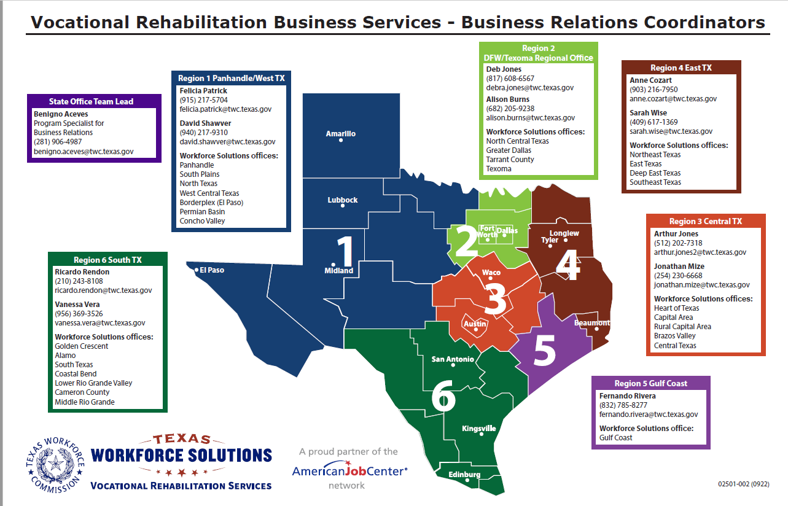
Business Relations Coordinator Map

Slide 21
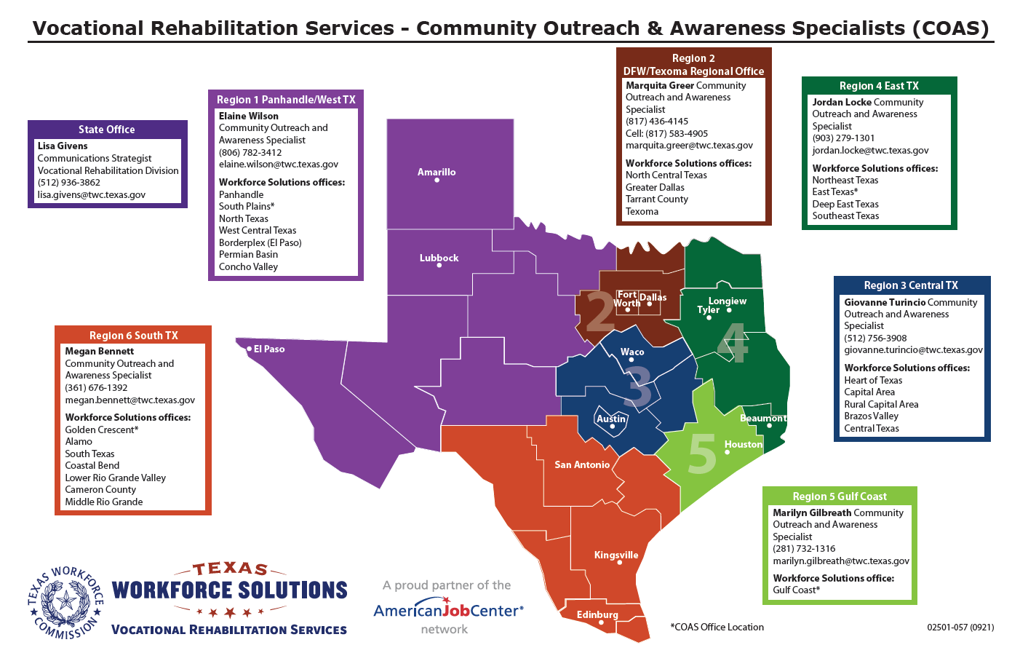
Community Outreach & Awareness Specialist Map

Slide 22
TXWORKS
Employer Flyer

Slide 23
TXWORKS
Student
Flyer

Slide 24
Contact Information for Julie Baker Gunter
Julie Baker Gunter
Program Supervisor for Customer and Provider Engagement Vocational Rehabilitation Division
1117 Trinity Street, Room 406T
Austin, TX 78778
Statewide Contact Number: (512) 936-6400
Statewide Email: vr.office.locator@twc.texas.gov
Cell phone: (512) 884-1248
julie.gunter@twc.texas.gov
www.twc.texas.gov

Slide 25
Contact Information for Marquita Greer
Marquita Greer, MS, LPC
Community Outreach and Awareness Specialist
Region 2 DFW/Texoma
Texas Workforce Solutions-Vocational Rehabilitation Services
1301 S. Bowen Rd., Suite 150 Arlington, TX 76013
Cell Phone: (817) 583-4905
Fax: (817) 436-4138
marquita.greer@twc.texas.gov
www.twc.texas.gov

Slide 26
Questions

